Slide 1
CSCI 230: Data Structures & Algorithms
Dr. X

Slide 2
Who am I?
Dr. X – Computer Scientist
PhD at North Carolina State University – Optical networks performance
Worked at IBM – Software Performance Engineer
Post doc at College of William and Mary – research on performance and power savings for hard disk drives
Assistant professor at Jacksonville University, Wofford College
Assistant professor at CofC
Scuba diver, manga comics collector, science fiction reader, hacker

Slide 3
Motivational quotes
“Every program depends on algorithms and data structures, but few programs depend on the invention of brand new ones.” -- Kernighan & Pike
“I will, in fact, claim that the difference between a bad programmer and a good one is whether he considers his code or his data structures more important. Bad programmers worry about the code. Good programmers worry about data structures and their relationships.” -- Linus Torvalds

Slide 4
The need for data structures…
Data structures organize data
⇒ more efficient programs.
More powerful computers
⇒ more complex applications.
More complex applications demand more calculations.
Notes:
A primary concern for this course is efficiency.
You might believe that faster computers make it unnecessary to be concerned with efficiency. However…
So we need special training.

Slide 5
Efficiency
Choice of data structure or algorithm can make the difference between a program running in a few seconds or many days.
A solution is said to be efficient if it solves the problem within its resource constraints.
Space
Time
The cost of a solution is the amount of resources that the solution consumes.
Notes:
Alternate definition: Better than known alternatives (“relatively efficient”).
Space and time are typical constraints for programs.
This does not mean always strive for the most efficient program. If the program operates well within resource constraints, there is no benefit to making it faster or smaller.

Slide 6
Selecting a Data Structure
Select a data structure as follows:
Analyze the problem to determine the basic operations that must be supported.
Quantify the resource constraints for each operation.
Select the data structure that best meets these requirements.

Slide 7
Logistics
Required Book: “Data Structures and Algorithms”, Cliff Shaffer and David Parillo. Available online at: https://opendsa-server.cs.vt.edu/ODSA/Books/CS2/html/
Public website: http://mountrouidoux.people.cofc.edu/CSCI230/index.html

Slide 8
Assignments
Homework – 25%: INDIVIDUAL, every two weeks
HW1: Single Linked List
HW2: Algorithmic Complexity
HW3: Double Linked List
HW4: Stacks, Queues, & Trees
HW5: Sorting
HW6: Hashes
HW7: Graphs
Participation and OpenDSA Assignments: 5%
Active participation in class – programming labs, Kahoot quizzes
Multiple choice questions related to reading assignments

Slide 9
Exams
Quizzes – 25% (every two weeks)
Closed book
NO cheat sheet allowed
Midterm – 20%
Closed book
One cheat sheet allowed
Final – 25%
Cumulative
Closed book
One cheat sheet allowed

Slide 10
Survival tips
Do not fall behind on the readings!!
Ask for my help
Ask for the TAs help
Use Slack to ask questions of visit us during office hours
Practice problem solving:
https://codestepbystep.com/
https://codingbat.com/java
He who asks a question is a fool for five minutes; he who does not ask a question remains a fool forever. – Chinese Proverb

Slide 11
Survival tips
Do not fall behind on the homework!!
Start early, ask a lot of questions
Do the homework on your own
You may search examples (even code) related to the lecture on the internet
You may not copy code from the internet
You may use videos, tutorials, blogs, to understand concepts
You may not copy code from these sources
Write pseudocode!
Use paper-pencil examples

Slide 12
Homework
Your file structure matters
Read the instructions carefully
You may lose a few (or more…) points if you do not submit appropriately

Slide 14
What is this class about?
Design decisions
Design analysis
Implementations of data structures
Debugging and testing
Abstract Data Types

Slide 15
Outline
Ch. 1 – ADTs
Ch. 2.1 – OO principles
Problem solving!!

Slide 16
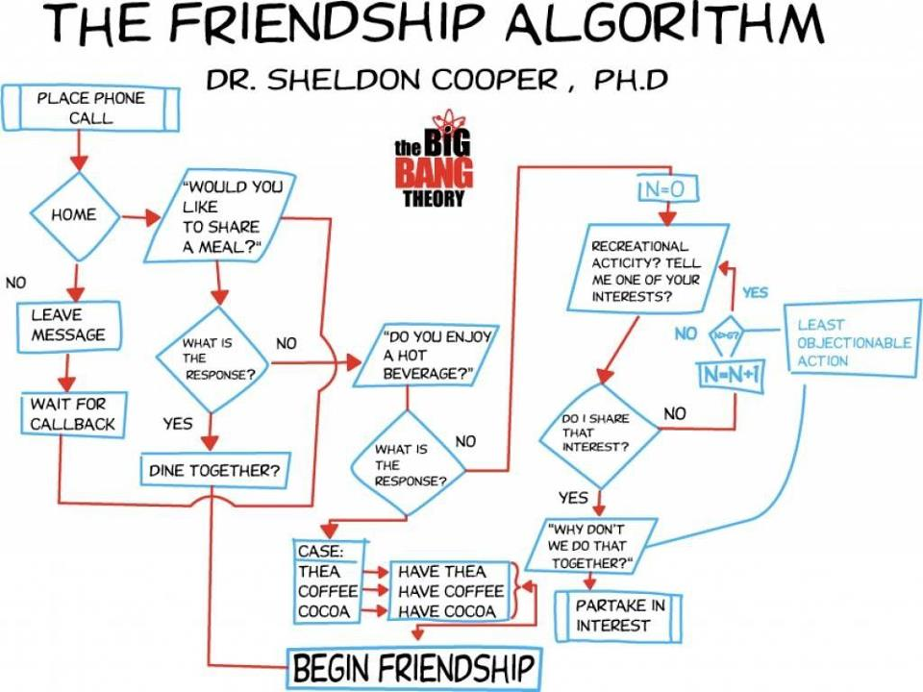
Basic definitions
What is a Data Structure?
What is an Algorithm?
Notes:
A way of organizing and storing related data points
A series of precise instructions used to perform a task

Slide 17
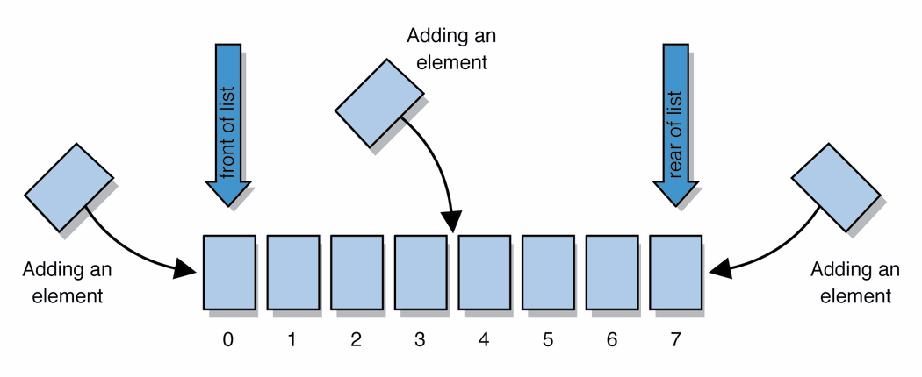
Abstract Data Types (ADT)
A definition for expected operations and behavior
List:
each element is accessible by a 0-based index
a list has a size (number of elements that have been added)
elements can be added to the front, back, or elsewhere
in Java, a list can be represented as an ArrayList object
Notes:
Start with the operations you want to do then define how those operations will play out on whatever data is being stored

Slide 18
Interfaces

Slide 19
ADTs we’ll discuss
List
Stack
Queue
Tree
Hash
Priority Queue
Graph

Slide 21
Kahoot time!

Slide 22
Case Study: The List ADT
list: stores an ordered sequence of information.
Each item is accessible by an index.
Lists have a variable size as items can be added and remove
List ADT
supported operations:
get(index): returns the item at the given index
set(value, index): sets the item at the given index to the given value
append(value): adds the given item to the end of the list
insert(value, index): insert the given item at the given index maintaining order
delete(index): removes the item at the given index maintaining order
size(): returns the number of elements in the list
state
Set of ordered items
Count of items
behavior
get(index) return item at index
set(item, index) replace item at index
append(item) add item to end of list
insert(item, index) add item at index
delete(index) delete item at index
size() count of items

Slide 23
Case Study: List Implementations
ArrayList
uses an Array as underlying storage
LinkedList
uses nodes as underlying storage
List ADT
ArrayList<E>
LinkedList<E>
state
Set of ordered items
Count of items
state
state
data[]
size
Node front
size
behavior
get(index) return item at index
set(item, index) replace item at index
append(item) add item to end of list
insert(item, index) add item at index
delete(index) delete item at index
size() count of items
behavior
behavior
get return data[index]
set data[index] = value
append data[size] = value, if out of space grow data
insert shift values to make hole at index, data[index] = value, if out of space grow data
delete shift following values forward
size return size
get loop until index, return node’s value
set loop until index, update node’s value
append create new node, update next of last node
insert create new node, loop until index, update next fields
delete loop until index, skip node
size return size
0 | 1 | 2 | 3 | 4
88.6 | 26.1 | 94.4 | 0 | 0
88.6
26.1
94.4
list
free space
Notes:
Code up an implementation of List

Slide 24
Design Decisions
For every ADT there are lots of different ways to implement them
Based on your situation you should consider:
Memory vs Speed
Generic/Reusability vs Specific/Specialized
One Function vs Another
Robustness vs Performance
This class is all about implementing ADTs based on making the right design tradeoffs!
> A common topic in interview questions

Slide 25
Dust off: OO programming
Encapsulation
Inheritance
Polymorphism

Slide 26
Kahoot time!

Slide 27
Problem solving time!

Slide 28
Sources
Duck duck go images for various sites (too many to list but I do not claim any of the images)
“Data Structures and Algorithms”, Cliff Shaffer and David Parillo.
CSE 373, Spring 2019, Washington State University, Lecture 1 slides (https://courses.cs.washington.edu/courses/cse373/19sp/files/lectures/slides/lecture01.pdf)

