Slide 1
Data Structures
Lecture: Algorithmic complexity

Slide 2
Lecture objectives
Define algorithms and how useful they are to solve the world’s problems
Understand algorithmic complexity
Use analytical thinking to estimate the complexity of your code
Learn the complexity lingo

Slide 3
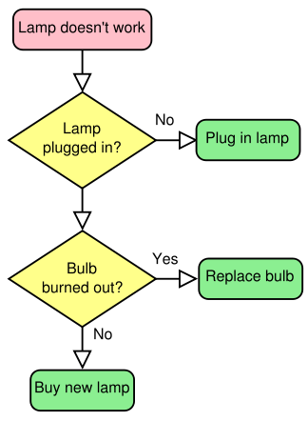
Algorithms
DS 2.2

Slide 4
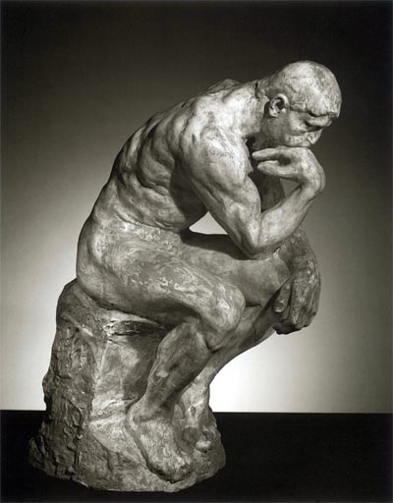
What is an algorithm?
Finite sequence of precise instructions that solve a problem or perform an action
Examples?
Notes:
Go to a building, do something
How to install…
Troubleshoot a machine
Fire extinguishing
Manual of your watch, iphone etc.

Slide 5
Algorithm vs. Program
Computer program:
Written in a programming language
Implements an algorithm
Algorithm:
Written in natural language
Solves a problem
Can algorithms solve every problem???

Slide 6
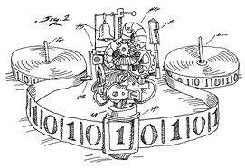
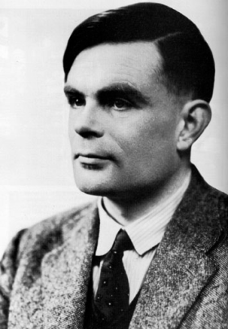
Can algorithms solve every problem?
Algorithms are countable.
Problems are uncountable.
There are too many problems, too few algorithms.
Turing halting problem.
Turing machine (i.e., a computer program) as an input.
It asks whether this Turing machine will halt.
Unfortunately, there is no algorithm that can solve this problem.
Notes:
while True: continue
Does not halt!!

Slide 7
Algorithm Efficiency
Big-O

Slide 8
Algorithm Complexity
How do we measure complexity?
Time
Space (memory)
Communication
Evaluate:
Average case
Worst case
Best case

Slide 9
Algorithm Complexity
Time: how many seconds does it take to execute our code?
Space: how much memory do we use?
Communication: how many exchanges with other programs, external input etc.
These vary:
From computer to computer
Different inputs to our program

Slide 10
Algorithm complexity and Java
What happens when you start running a java program?
Load the JVM (Java Virtual Machine)
The .class file of your program is loaded
The .class files referenced by you program are loaded
Finally your program executes

Slide 11
Algorithm Efficiency and Big-O
Precise measure of the performance of an algorithm is difficult
Java profilers: pros and cons
Big-O: performance of an algorithm as a function of the number of items to be processed
Algorithm comparison
Very large problems

Slide 12
Linear Growth Rate
Processing time increases in proportion to the number of inputs N:
public static int search(int[] x, int target) {
for(int i=0; i<x.length; i++) {
if (x[i]==target)
return i;
}
return -1; // target not found
}

Slide 13
Linear Growth Rate
for loop MAY execute x.length times, why?
for loop may execute (on average) (x.length + 1)/2 times
Total execution time is directly proportional to x.length
Growth rate of order n OR
O(n)
Processing time increases in proportion to the number of inputs n:
public static int search(int[] x, int target) {
for(int i=0; i<x.length; i++) {
if (x[i]==target)
return i;
}
return -1; // target not found
}

Slide 14
n x m Growth Rate
Processing time can be dependent on two different inputs
public static boolean areDifferent(int[] x, int[] y) {
for(int i=0; i<x.length; i++) {
if (search(y, x[i]) != -1)
return false;
}
return true;
}

Slide 15
n x m Growth Rate (cont.)
for loop executes x.length times
search, executes y.length times
Total execution time proportional to: (x.length * y.length)
Growth rate has an order of n x m or
O(n x m)
Processing time can be dependent on two different inputs.
public static boolean areDifferent(int[] x, int[] y) {
for(int i=0; i<x.length; i++) {
if (search(y, x[i]) != -1)
return false;
}
return true;
}

Slide 16
Quadratic Growth Rate
Proportional to the square of the number of inputs n
public static boolean areUnique(int[] x) {
for(int i=0; i<x.length; i++) {
for(int j=0; j<x.length; j++) {
if (i != j && x[i] == x[j])
return false;
}
}
return true;
}

Slide 17
Big-O Notation
O()
"order of magnitude“
OR upper bound
Look at loops in the code
Assuming a loop body consists only of simple statements,
a single loop is O(n)
a pair of nested loops is O(n²)
a nested pair of loops inside another is O(n³)
and so on . . .

Slide 18
Big-O Notation (cont.)
Examine the number of times a loop is executed
for(i=1; i < x.length; i *= 2) {
// Do something with x[i]
}
The loop body will execute k-1 times, with i having the following values: 1, 2, 4, 8, 16, . . ., 2^{k} until 2^{k} is greater than x.length
Since 2^{k-1} = x.length < 2^{k} and log₂2^{k} is k, we know that k-1 = log₂(x.length) < k
O(log n)

Slide 19
Formal Definition of Big-O
for (int i = 0; i < n; i++) {
for (int j = 0; j < n; j++) {
Simple Statement
}
}
for (int i = 0; i < n; i++) {
Simple Statement 1
Simple Statement 2
Simple Statement 3
Simple Statement 4
Simple Statement 5
}
Simple Statement 6
Simple Statement 7
... Simple Statement 30

Slide 20
Formal Definition of Big-O (cont.)
for (int i = 0; i < n; i++) {
for (int j = 0; j < n; j++) {
Simple Statement
}
}
for (int i = 0; i < n; i++) {
Simple Statement 1
Simple Statement 2
Simple Statement 3
Simple Statement 4
Simple Statement 5
}
Simple Statement 6
Simple Statement 7
... Simple Statement 30
This nested loop executes a Simple Statement n² times

Slide 21
Formal Definition of Big-O (cont.)
for (int i = 0; i < n; i++) {
for (int j = 0; j < n; j++) {
Simple Statement
}
}
for (int i = 0; i < n; i++) {
Simple Statement 1
Simple Statement 2
Simple Statement 3
Simple Statement 4
Simple Statement 5
}
Simple Statement 6
Simple Statement 7
... Simple Statement 30
This loop executes 5 Simple Statements n times (5n)

Slide 22
Formal Definition of Big-O (cont.)
for (int i = 0; i < n; i++) {
for (int j = 0; j < n; j++) {
Simple Statement
}
}
for (int i = 0; i < n; i++) {
Simple Statement 1
Simple Statement 2
Simple Statement 3
Simple Statement 4
Simple Statement 5
}
Simple Statement 6
Simple Statement 7
... Simple Statement 30
Finally, 25 Simple Statements are executed

Slide 23
Formal Definition of Big-O (cont.)
for (int i = 0; i < n; i++) {
for (int j = 0; j < n; j++) {
Simple Statement
}
}
for (int i = 0; i < n; i++) {
Simple Statement 1
Simple Statement 2
Simple Statement 3
Simple Statement 4
Simple Statement 5
}
Simple Statement 6
Simple Statement 7
... Simple Statement 30
The complexity of this code is:
T(n) = n² + 5n + 25
Notes:
If n=5, 6, etc. n^2 is not so dominating
But if n=1000??

Slide 24
Formal Definition of Big-O (cont.)
In terms of T(n),
T(n) = O(f(n))
There exist
two constants, n₀ and c, greater than zero, and
a function, f(n), such that for all n > n₀, cf(n) ≥ T(n)
T(n) is an upper bound for this code.
Worst case scenario!
T(n) = O(f(n)) means T(n) grows
no faster than f(n) asymptotically
Notes:
In other words, as n gets sufficiently large (larger than n₀), there is some constant c for which the processing time will always be less than or equal to cf(n)
cf(n) is an upper bound on performance
Asymptotic versus exact: distance approaches to zero but lines never meet

Slide 25
Formal Definition of Big-O (cont.)
Growth rate of f(n) == fastest growing term
In the example, an algorithm of
O(n² + 5n + 25)
is more simply expressed as
O(n²)
Rules of thumb:
Ignore all constants
Drop the lower-order terms

Slide 26
Big-O Example 1
Given T(n) = n² + 5n + 25, show that this is O(n²)
Find constants n₀ and c so that, for all n > n₀, cn² > n² + 5n + 25
Find the point where cn² = n² + 5n + 25
Let n = n₀, and solve for c
c = 1 + 5/ n₀, + 25/ n₀ ²
When n₀ is 5(1 + 5/5 + 25/25), c is 3
So, 3n² > n² + 5n + 25 for all n > 5
Other values of n₀ and c also work

Slide 27
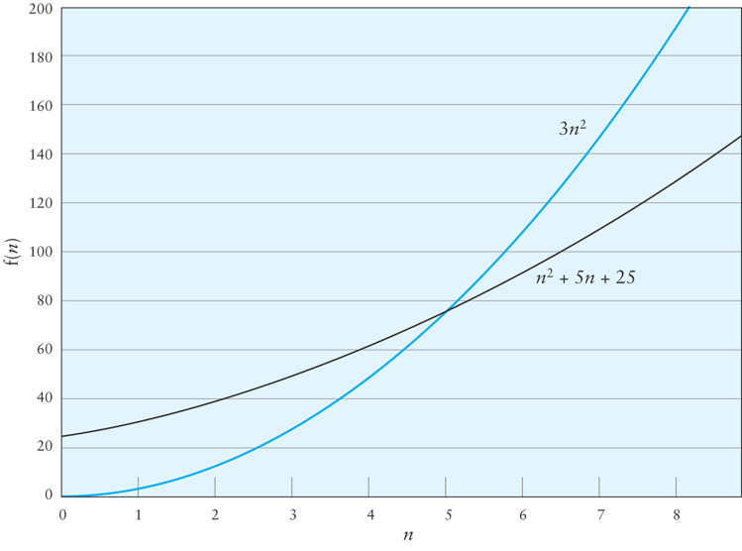
Big-O Example 1 (cont.)
Notes:
If the coefficients are positive, find a value of n that is equal to the rest of the terms

Slide 28
Big-O Example 2
Consider the following loop
for (int i = 0; i < n; i++) {
for (int j = i + 1; j < n; j++) {
3 simple statements
}
}
T(n) = 3(n – 1) + 3 (n – 2) + … + 3
Factoring out the 3,
3(n – 1 + n – 2 + n + … + 1)
1 + 2 + … + n – 1 = (n x (n-1))/2

Slide 29
Big-O Example 2 (cont.)
Therefore T(n) = 1.5n² – 1.5n
When n = 0, the polynomial has the value 0
For values of n > 1, 1.5n² > 1.5n² – 1.5n
Therefore T(n) is O(n²) when n₀ is 1 and c is 1.5

Slide 30
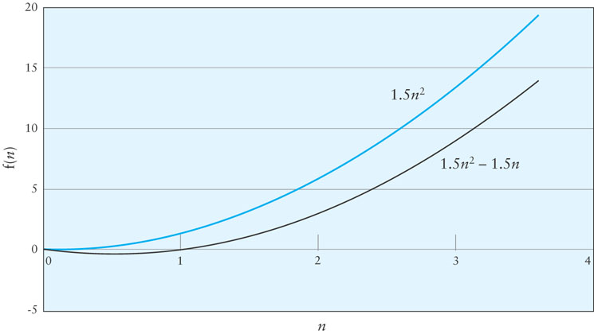
Big-O Example 2 (cont.)

Slide 31
Symbols Used in Quantifying Performance
Symbol | Meaning
T(n) | Time method or program takes as a function of the number of inputs n
f(n) | Any function of n
O(f(n)) | Order of magnitude of functions that grow no faster than f(n)

Slide 32
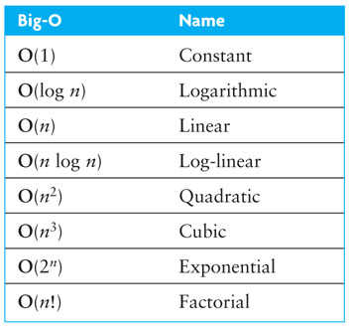
Common Growth Rates
Notes:
... < log(n) < sqrt(n) < n < n^2 < ... < a^n < n! < n^n < ...

Slide 33
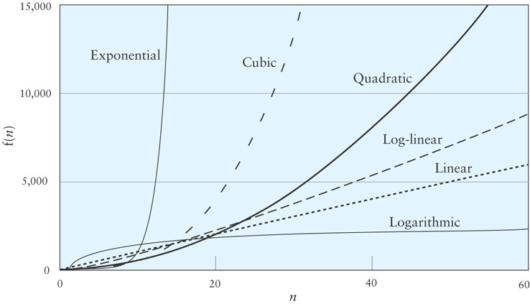
Different Growth Rates
Notes:
Exp is smaller than all others for small n
Linear larger than quadratic for n<20
For small values of n a less efficient algorithm may be better
Growth rate is important!!

Slide 34
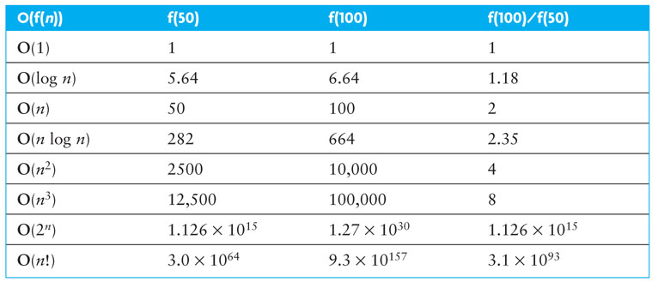
Effects of Different Growth Rates
Notes:
Ratio shows it will take f(100)/f(50) times to process 100 numbers as it would to process 50 numbers

Slide 35
Algorithms with Exponential and Factorial Growth Rates
Algorithms with exponential and factorial growth rates have an effective practical limit on the size of the problem they can be used to solve
With an O(2^{n}) algorithm, if 100 inputs takes an hour then,
101 inputs will take 2 hours
105 inputs will take 32 hours
114 inputs will take 16,384 hours (almost 2 years!)

Slide 36
Algorithms with Exponential and Factorial Growth Rates (cont.)
Encryption algorithms take advantage of this characteristic
Some cryptographic algorithms can be broken in O(2^{n}) time, where n is the number of bits in the key
A key length of 40 is considered breakable by a modern computer,
But a key length of 100 bits will take a billion-(billion (10¹⁸) ) times longer than a key length of 40

Slide 37
Practice
What is the big O of f(n)=n²+n²log(n) ?
What is the big O of f(n)=n³+n²log(n) ?
What is the big O of f(n)= (nlog(n)+n²) (n+log(n))?

Slide 38
Algorithm Efficiency
Other complexities…

Slide 39
More Greek letters
Big-Omega: T(n) = Ω(f(n))
There exist
two constants, n₀ and c, greater than zero, and
a function, f(n), such that for all n > n₀, cf(n) ≤ T(n)
Best case!
Lower bound
Means T(n) grows no slower than f(n) asymptotically

Slide 40
Big-Omega
We say T(n)=Ω(f(n)) if f(n)=O(T(n)).
Example:
Since log n= O(n)
Then n= Ω(log n)
Example: n ^{1/2} = Ω( lg n) .
Use the definition with c = 1 and n₀ = 16. Checks OK. Let n > 16: n ^{1/2} > (1) lg n if and only if n > ( lg n )²
by squaring both sides.

Slide 41
Big-Theta
Big-Theta: T(n) = $Ρ$(f(n))
Best fit!
Bounded above and below by f(n)
T(n)= Θ(f(n)) if and only if f(n)=Θ(T(n)).
T(n)=Θ(f(n))
if and only if f(n)= Ω(T(n)) and T(n)=Ω(f(n)).
Notes:
Big-O is an upper bound.
Big-Theta is a tight bound, i.e. upper and lower bound.
When people only worry about what's the worst that can happen, big-O is sufficient; i.e. it says that "it can't get much worse than this". The tighter the bound the better, of course, but a tight bound isn't always easy to compute.

Slide 42
Big-Theta
Example: T(n) = n² - 5n + 13.
The constant 13 doesn't change as n grows, so it is not crucial. The low order term, -5n, doesn't have much effect on f compared to the quadratic term, n².
Q: What does it mean to say T(n) = Θ(f(n))?
A: Intuitively, it means that function T is the same order of magnitude as f.

Slide 43
Big-Theta
T(n) = 73n³+ 22n²+ 58
T(n) = O(n¹⁰⁰), which is identical to T(n) ∈ O(n¹⁰⁰)
T(n) = O(n³), which is identical to T(n) ∈ O(n³)
T(n) = Θ(n³), which is identical to T(n) ∈ Θ(n³)
The equivalent English statements are respectively:
T(n) grows asymptotically no faster than n¹⁰⁰
T(n) grows asymptotically no faster than n³
T(n) grows asymptotically as fast as n³.

Slide 44
Big-O vs Big-Theta
If an algorithm is of Θ(f(n)), it means that the running time of the algorithm as n (input size) gets larger is proportional to f(n).
If an algorithm is of O(f(n)), it means that the running time of the algorithm as n gets larger is at most proportional to f(n).

Slide 45
P vs NP problems
Back to the question:
Can algorithms solve any problem???
P: deterministic polynomial
Good news: can be solved in deterministic time
NP: non deterministic polynomial
No fast solution
They grow very fast!
Why should we care?
Many NP complete problems out there!

Slide 46
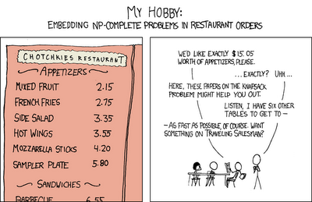
P vs NP problems

Slide 47
P vs NP problems

