Slide 1
On to Object Design
c. 14

Slide 2
UML CASE Tools
Integrate with strong IDEs
Reverse engineer diagrams
Notes:
How much time on UML? A few hrs at beginning of iteration

Slide 3
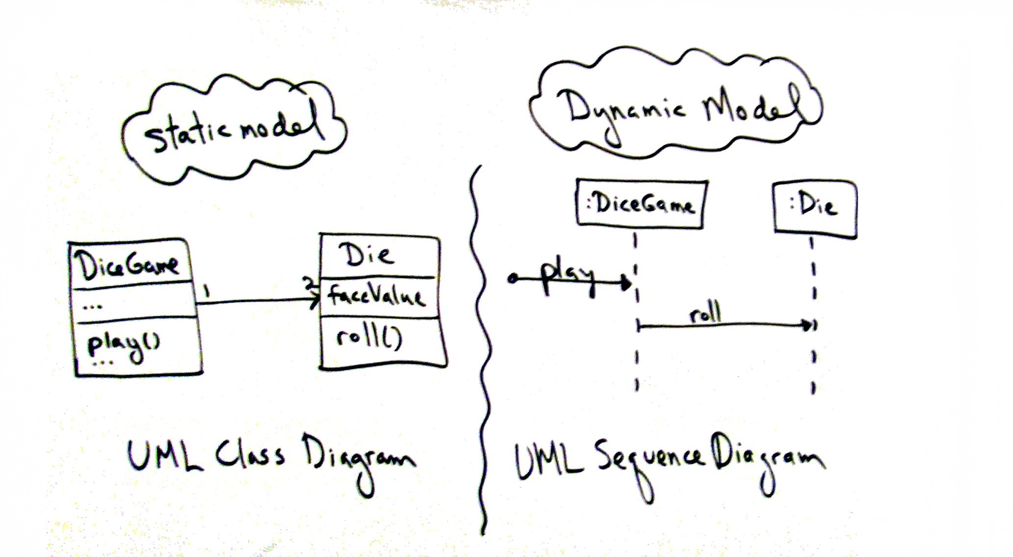
What are Static and Dynamic Modeling?
Notes:
Dynamic: sequence, communication, activity, state diagrams, help design logic, behavior, method bodies
Static: class, packages, names, attributes, method signatures
Spend significant time on… dynamic!
GRASP: General Responsibility Assignment Software Patterns or Principles – responsibility-driven design
What are the responsibilities of the object? Who does it collaborate with? What design patterns should be applied? More important than UML

Slide 4
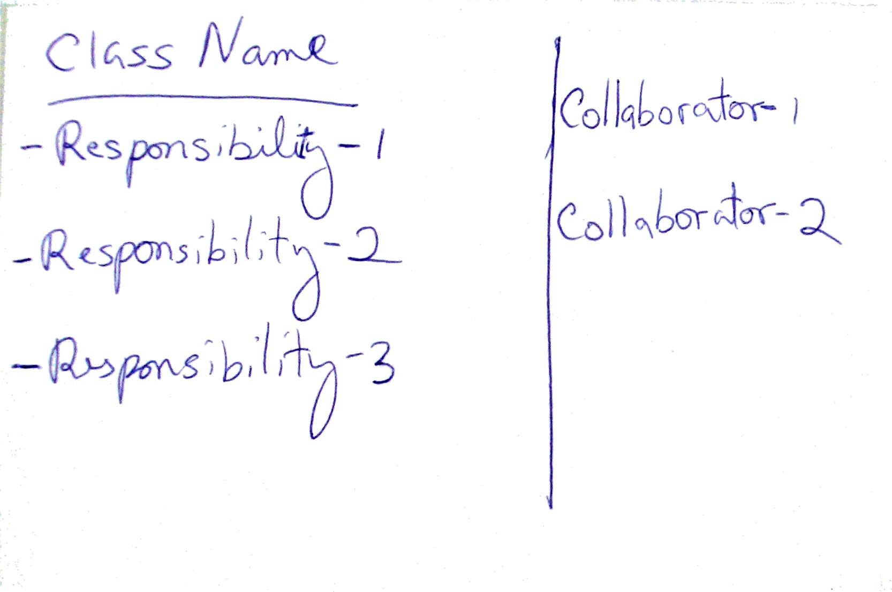
Class Responsibility Collaboration (CRC) Cards
Notes:
What-if scenarios: what objs must do, what other objs they collaborate with

