Slide 1
GRASP*: Designing Objects with Responsibilities
* General Responsibility Assignment Software Patterns
Ch. 17

Slide 2
Responsibilities and Methods
The focus of object design is to identify classes and objects, decide what methods belong where and how these objects should interact.
Responsibilities are related to the obligations of an object in terms of its behavior.
Two types of responsibilities:
Doing:
Doing something itself (e.g. creating an object, doing a calculation)
Initiating action in other objects.
Controlling and coordinating activities in other objects.
Knowing:
Knowing about private encapsulated data.
Knowing about related objects.
Knowing about things it can derive or calculate.
Notes:
Responsibility driven design (RDD)
Responsibility: a contract or obligation of a classifier
RDD as a metaphor: people collaborating to get a job done, community of collaborating objects

Slide 3
Responsibilities and Methods
Responsibilities are assigned to classes during object design. For example, we may declare the following:
“a Sale is responsible for creating SalesLineItems” (doing)
“a Sale is responsible for knowing its total” (knowing)
Responsibilities related to “knowing” are often inferable from the Domain Model (because of the attributes and associations it illustrates)
Notes:
Interaction diagrams: decide on responsibilities
Domain mode helps with Low Representational Gap (LRG): how we think of the domain and a straightforward correspondence with sw objects.
Who is responsible for creating a square in the monopoly game?
Intuition

Slide 4
Responsibilities and Methods
The translation of responsibilities into classes and methods is influenced by the granularity of responsibility.
A responsibility is not the same thing as a method, but methods are implemented to fulfill responsibilities.
Methods either act alone, or collaborate with other methods and objects.
Notes:
For example, “provide access to relational databases” may involve dozens of classes and hundreds of methods, whereas “create a Sale” may involve only one or few methods.

Slide 5
Responsibilities and Interaction Diagrams
Sale objects have been given the responsibility to create Payments, handled with the makePayment method.
:Sale
makePayment(…)
create(…)
:Payment
Notes:
Within the UML artifacts, a common context where these responsibilities (implemented as methods) are considered is during the creation of interaction diagrams.

Slide 6
Patterns
We will emphasize principles (expressed in patterns) to guide choices in where to assign responsibilities.
A pattern is a named description of a problem and a solution that can be applied to new contexts; it provides advice in how to apply it in varying circumstances. For example,
Pattern name: Information Expert
Problem: What is the most basic principle by which to assign responsibilities to objects?
Solution: Assign a responsibility to the class that has the information needed to fulfil it.
Notes:
A well known problem-solution pair that can be applied in new concepts

Slide 7
Information Expert (or Expert)
Problem: what is a general principle of assigning responsibilities to objects?
Solution: Assign a responsibility to the information expert - the class that has the information necessary to fulfill the responsibility.
In the NextGen POS application, who should be responsible for knowing the grand total of a sale?
By Information Expert we should look for that class that has the information needed to determine the total.

Slide 8
Information Expert (or Expert)
Do we look in the Domain Model or the Design Model to analyze the classes that have the information needed?
A: Both. Assume there is no or minimal Design Model. Look to the Domain Model for information experts.

Slide 9
Information Expert (or Expert)
It is necessary to know about all the SalesLineItem instances of a sale and the sum of the subtotals.
A Sale instance contains these, i.e. it is an information expert for this responsibility.
Sale
date
time
Contains
1..*
SalesLineItem
Described-by
Product
Specification
quantity
*
1
description
price
itemID

Slide 10
Information Expert (or Expert)
This is a partial interaction diagram.
t := getTotal()
:Sale

Slide 11
Information Expert (or Expert)
What information is needed to determine the line item subtotal?
quantity and price.
SalesLineItem should determine the subtotal.
This means that Sale needs to send getSubtotal() messages to each of the SalesLineItems and sum the results.
t := getTotal()
:Sale
1 *: st := getSubtotal()
:SalesLineItem

Slide 12
Information Expert (or Expert)
To fulfil the responsibility of knowing and answering its subtotal, a SalesLineItem needs to know the product price.
The ProductSpecification is the information expert on answering its price.
t := getTotal()
:Sale
1 *: st := getSubtotal()
:SalesLineItem
1.1: p := getPrice()
:ProductSpecification

Slide 13
Information Expert (or Expert)
To fulfil the responsibility of knowing and answering the sale’s total, three responsibilities were assigned to three design classes
The fulfillment of a responsibility often requires information that is spread across different classes of objects. This implies that there are many “partial experts” who will collaborate in the task.
Class Responsibility
Sale Knows Sale total
SalesLineItem Knows line item total
ProductSpecification Knows product price
Notes:
Intuition: objects do things based on the information that they have
Information spread across classes of objects
“Do It Myself” in the OO world objects are alive or animated, they can take responsibilities and do things
Animation principle: like being in a cartoon where everything is alive
Expert: give information to fulfill task
Benefits: info encapsilation, distributed behavior,

Slide 14
Creator
Problem: Who should be responsible for creating a new instance of some class?
Solution: Assign class B the responsibility to create an instance of class A if one or more of the following is true:
B aggregates A objects.
B contains A objects.
B records instances of A objects.
B has the initializing data that will be passed to A when it is created (thus B is an Expert with respect to creating A).

Slide 15
Creator
In the POS application, who should be responsible for creating a SalesLineItem instance?
Since a Sale contains many SalesLineItem objects, the Creator pattern suggests that Sale is a good candidate.
Sale
date
time
Contains
1..*
SalesLineItem
Described-by
Product
Specification
quantity
*
1
description
price
itemID

Slide 16
Creator
This assignment of responsibilities requires that a makeLineItem method be defined in Sale.
:Sale
makeLineItem(quantity)
create(quantity)
:SalesLineItem

Slide 17
Low Coupling
Coupling: it is a measure of how strongly one element is connected to, has knowledge of, or relies upon other elements.
A class with high coupling depends on many other classes (libraries, tools).
Problems because of a design with high coupling:
Changes in related classes force local changes.
Harder to understand in isolation; need to understand other classes.
Harder to reuse because it requires additional presence of other classes.
Problem: How to support low dependency, low change impact and increased reuse?
Solution: Assign a responsibility so that coupling remains low.
Notes:
Low coupling decreases the time, effort, and defects to change and maintain sw
Promotes object independence -> reduces impact of change

Slide 18
Low Coupling
Assume we need to create a Payment instance and associate it with the Sale.
What class should be responsible for this?
By Creator, Register is a candidate.
:Register
:Payment
:Sale

Slide 19
Low Coupling
makePayment()
Register could then send an addPayment message to Sale, passing along the new Payment as a parameter.
The assignment of responsibilities couples the Register class to knowledge of the Payment class.
1: create()
:Register
p:Payment
2:addPayment(p)
:Sale
Sale also coupled to
knowledge of a Payment.

Slide 20
Low Coupling
makePayment()
An alternative solution is to create Payment and associate it with the Sale.
No coupling between Register and Payment.
1: makePayment()
:Register
:Sale
1.1. create()
:Payment

Slide 21
Low Coupling
Some of the places where coupling occurs:
Attributes: X has an attribute that refers to a Y instance.
Methods: e.g. a parameter or a local variable of type Y is found in a method of X.
Subclasses: X is a subclass of Y.
Types: X implements interface Y.
There is no specific measurement for coupling, but in general, classes that are generic and simple to reuse have low coupling.
There will always be some coupling among objects, otherwise, there would be no collaboration.

Slide 22
High Cohesion
Cohesion: it is a measure of how strongly related and focused the responsibilities of an element are.
A class with low cohesion does many unrelated activities or does too much work.
Problems because of a design with low cohesion:
Hard to understand.
Hard to reuse.
Hard to maintain.
Delicate, affected by change.
Problem: How to keep complexity manageable?
Solution: Assign a responsibility so that cohesion remains high.
Notes:
Correlates to low coupling and Expert
Modularity: decomposed into set of cohesive and loosely coupled modules
Benefits: clarity, ease of comprehension, maintenance and enhancements simplified, reuse is increased

Slide 23
High Cohesion
Assume we need to create a Payment instance and associate it with Sale. What class should be responsible for this?
By Creator, Register is a candidate.
Register may become bloated if it is assigned more and more system operations.
:Register
:Sale
makePayment()
create()
p:Payment
addPayment(p)

Slide 24
High Cohesion
An alternative design delegates the Payment creation responsibility to the Sale, which supports higher cohesion in the Register.
This design supports high cohesion and low coupling.
:Register
:Sale
makePayment()
makePayment()
create()
:Payment

Slide 25
High Cohesion
Scenarios that illustrate varying degrees of functional cohesion
Very low cohesion: class responsible for many things in many different areas.
e.g.: a class responsible for interfacing with a data base and remote-procedure-calls.
Low cohesion: class responsible for complex task in a functional area.
e.g.: a class responsible for interacting with a relational database.

Slide 26
High Cohesion
3. High cohesion: class has moderate responsibility in one functional area and it collaborates with other classes to fulfill a task.
e.g.: a class responsible for one section of interfacing with a data base.
Rule of thumb: a class with high cohesion has a relative low number of methods, with highly related functionality, and doesn’t do much work. It collaborates and delegates.

Slide 27
Controller
Problem: Who should be responsible for handling an input system event?
Solution: Assign the responsibility for receiving or handling a system event message to a class representing one of he following choices:
Represents the overall system.
Represents a use case scenario.
A Controller is a non-user interface object that defines the method for the system operation. Note that windows, applets, etc. typically receive events and delegate them to a controller.
Notes:
What first object after or beyond the UI layer should receive a message from the UI layer? Controller!
Do you see the connections between the SSD, domain model, and UI layer?
Controller connects application layer to UI layer
Controller: first object beyond UI layer that is responsible for receiving or handling a system operation message

Slide 28
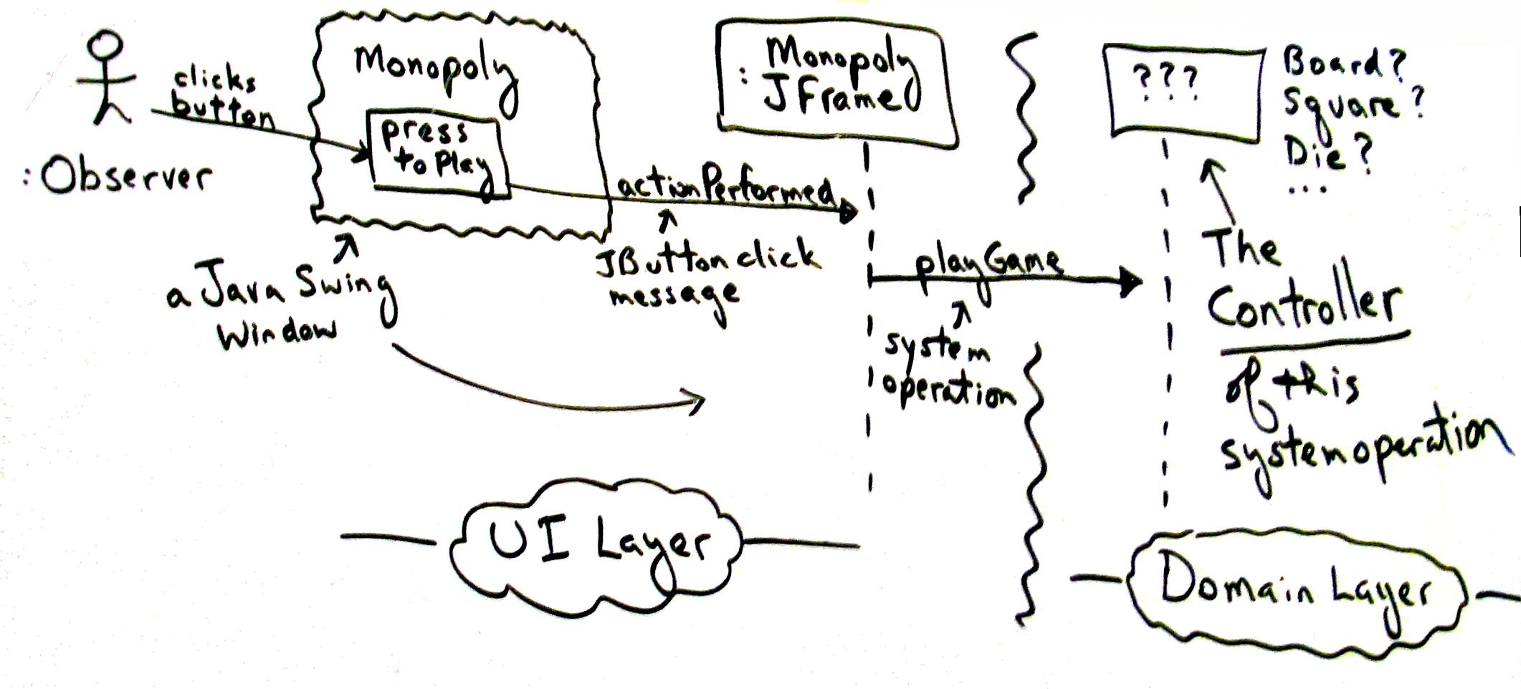
Fig. 17.9
Notes:
Which class should be controller?

Slide 29
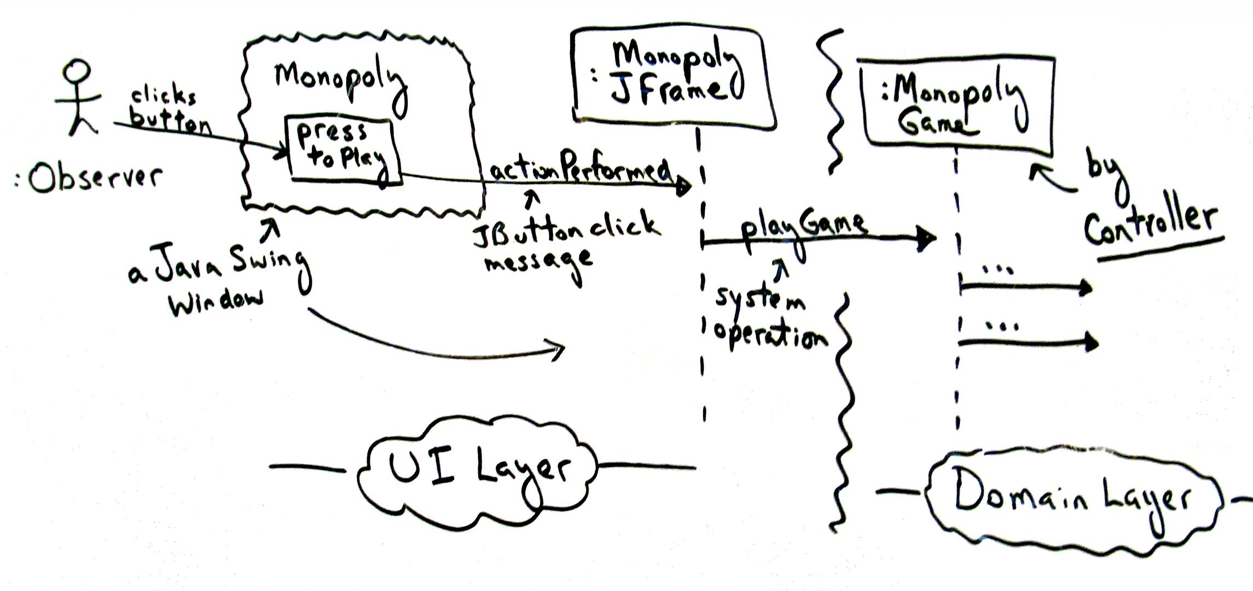
Fig. 17.10

Slide 30
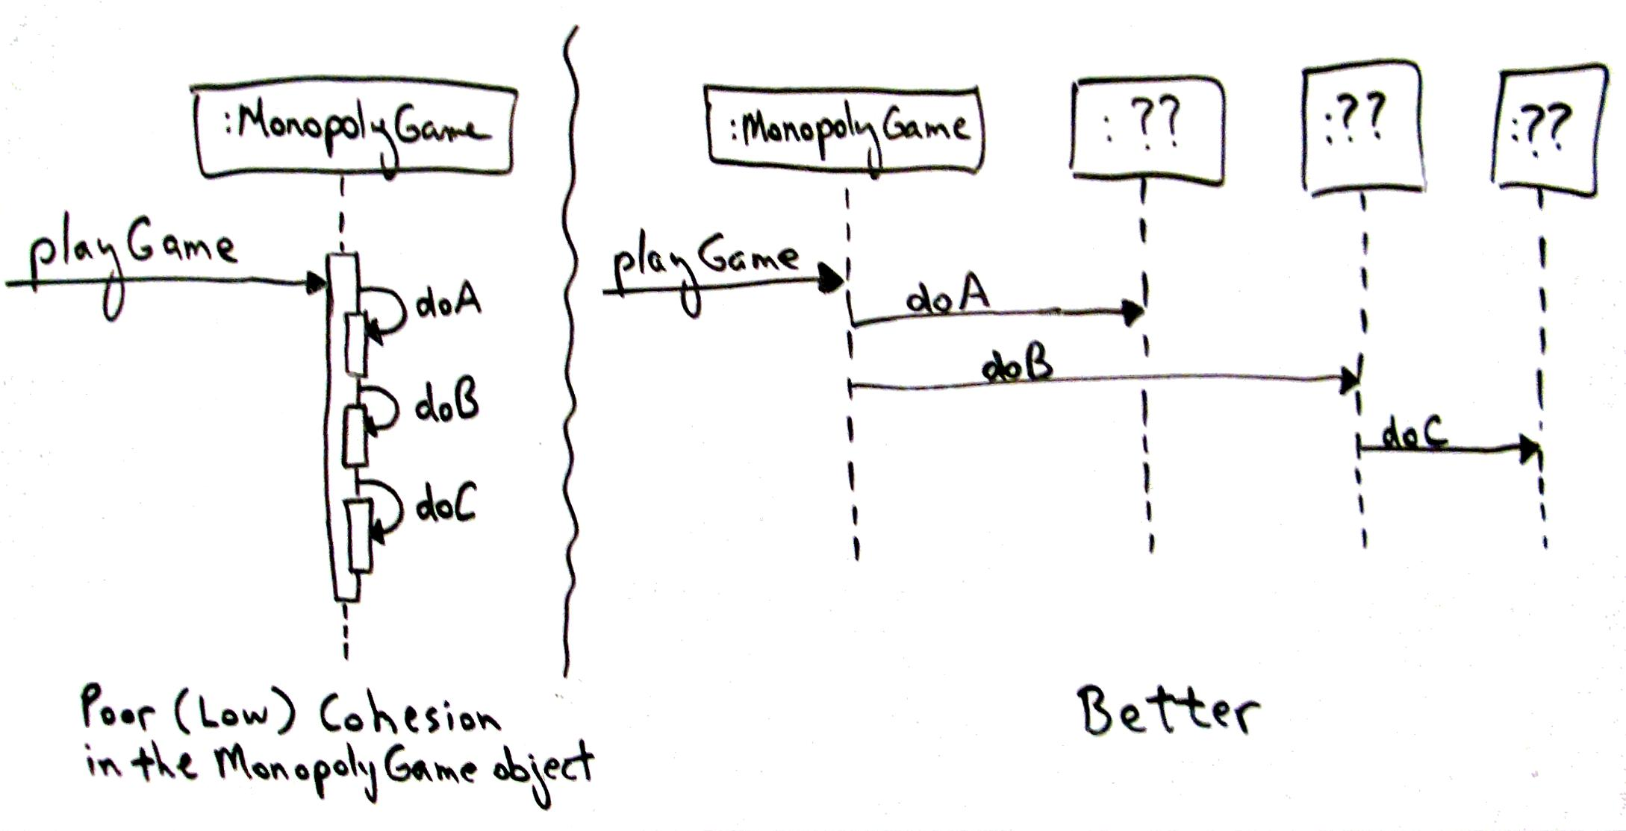
Fig. 17.11
Notes:
Cohesion measures how functionally related operations of a sw element are and also measures how much work a sw element is doing

Slide 31
Fig. 17.21
Notes:
Command pattern, command processor pattern – telecommunication switch, control plane, data plane.

