Slide 1
GRASP
Ch. 25

Slide 2
GRASP
Polymorphism
Indirection
Pure Fabrication
Protected Variations

Slide 3
Polymorphism
Problem: How to handle alternatives based on type? How to create pluggable sw components?
Solution: When related alternatives or behaviors vary by type (class) assign responsibilities for the behavior using polymorphic operations to the types for which the behavior varies

Slide 4
Fig. 25.1
Notes:
Polymorphism in adapting to different external tax calculators
Polymorphic getTaxes operation

Slide 5
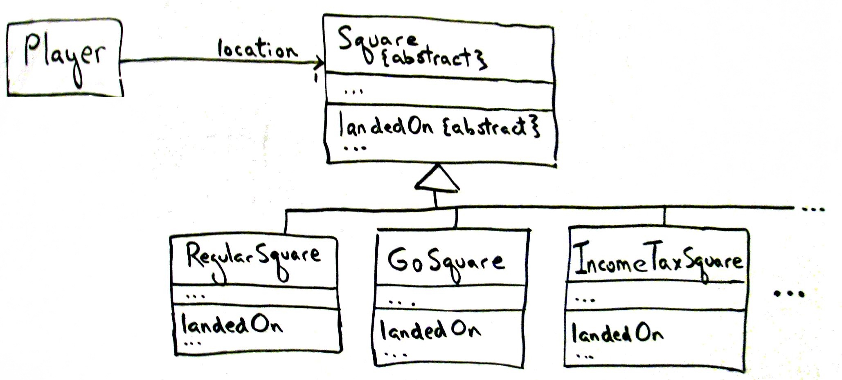
Fig. 25.2
Notes:
Switch on square.design
Case regularSquare
Case goSquare
Why abstract and not interface?

Slide 6
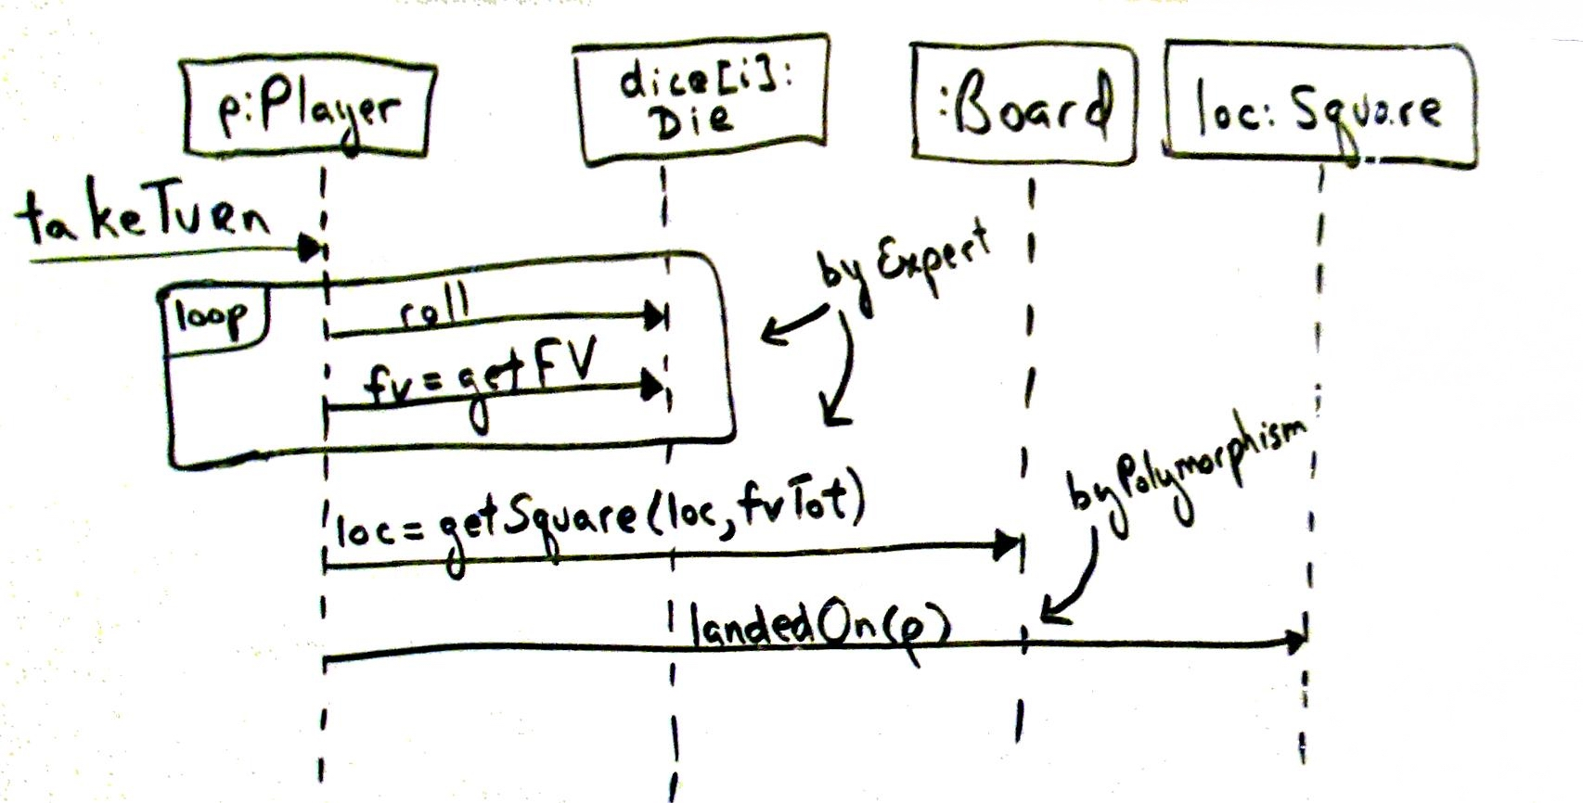
Fig. 25.3
Notes:
Loc passed as parameter in get square
P passed as parameter in landed on

Slide 7
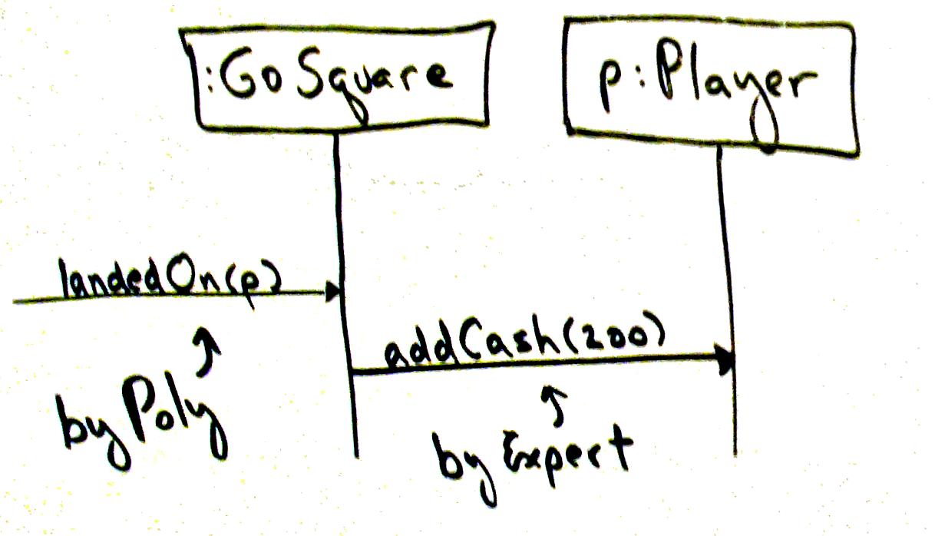
Fig. 25.4
Notes:
Use case GoSquare

Slide 8
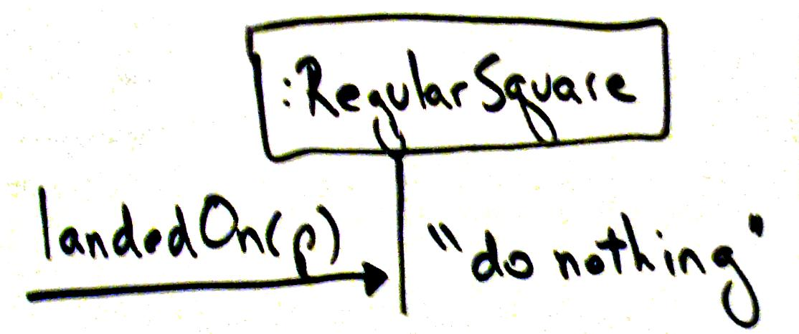
Fig. 25.5
Notes:
Use case RegularSquare

Slide 9
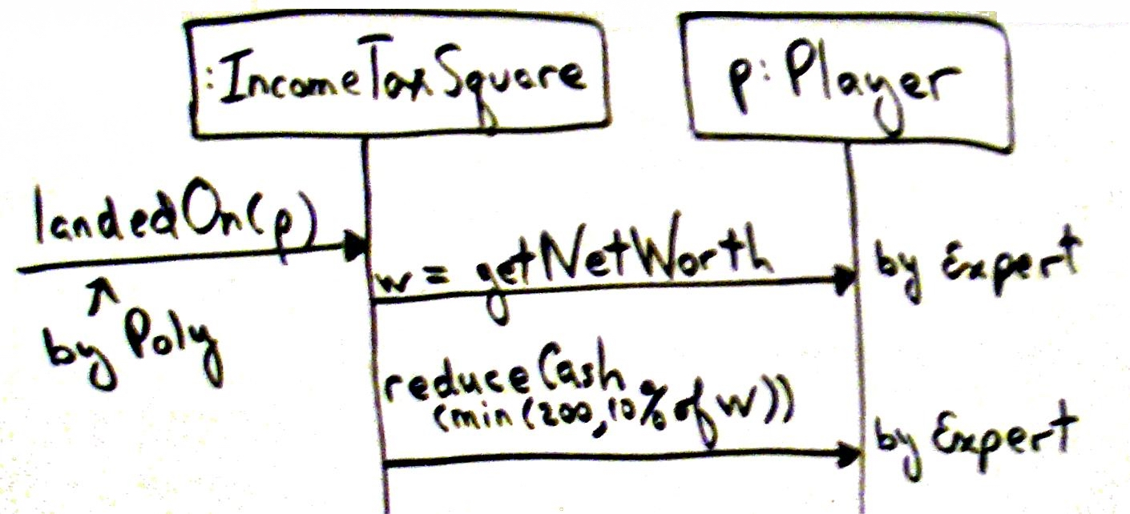
Fig. 25.6
Notes:
Use case Income Tax Square

Slide 10
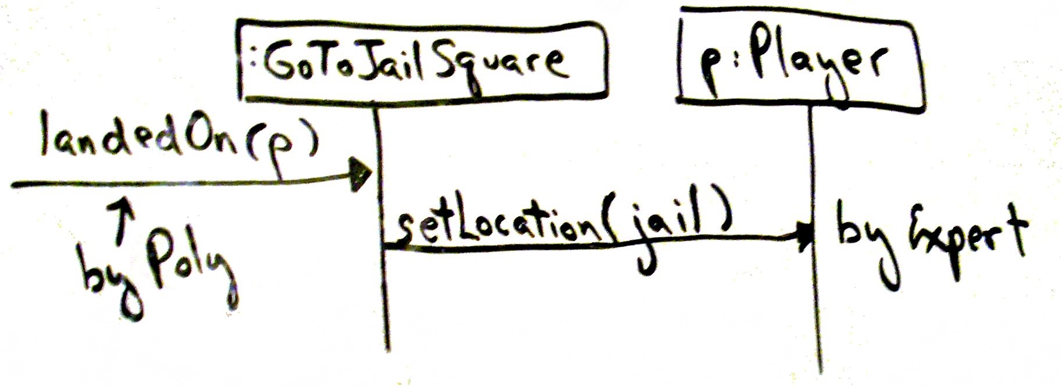
Fig. 25.7
Notes:
When to design with interfaces?

Slide 11
Pure Fabrication
Problem: What object should have the responsibility when you do not want to violate high cohesion and low coupling or other goals but solutions offered by others, such as Expert, are not appropriate?
Solution: Assign highly cohesive set of responsibilities to an artificial or convenience class that does not represent a problem domain concept.
Notes:
POS Persistent Storage: Adapter between Sale and Database

Slide 12
Fig. 25.8

Slide 13
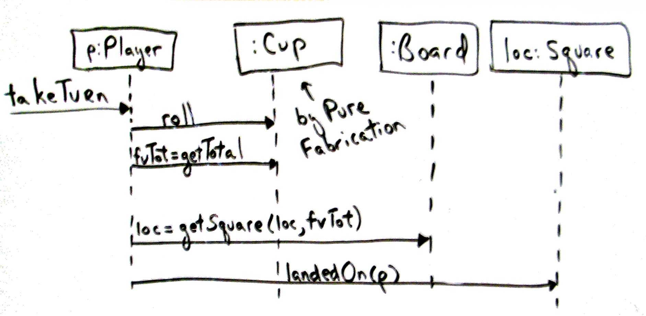
Fig. 25.9

Slide 14
Indirection
Problem: Where to assign responsibility to avoid direct coupling between two or more things?
Solution: Assign the responsibility to an intermediate object
Notes:
Most problems in CS can be solved with another level of indirection
PersistentStorage can also be considered indirection
Protects inner design against variations in external i/fs

Slide 15
Fig. 25.10

Slide 16
Protected Variations
Problem: How to design objects, subsystems, and systems so that variations and instabilities in these elements does not have undesirable impact on other elements?
Solution: Identify points of predicted variation or instability; assign responsibilities to create a stable interface around them.
Notes:
I/f here has a broader view! Not just Java
Fundamental design principle, any design pattern is a specialization of PV
Data encapsulation, interfaces, polymorphism: all for PV
Information hiding
Law of Demeter (Don’t talk to strangers)
LSP
OCP
One ring to rule them all, One ring to find them, One ring to bring them all and in the darkness bind them.

