Slide 1
Use cases
Dr. X

Slide 2
Overview
Use cases are one way to capture (especially) functional requirements.
They are stories of using a system.
You will be able to:
Identify different use case levels
Write use cases in the popular Cockburn format
Contrast essential and concrete use cases
Apply guidelines
Read and write use case diagrams

Slide 3
DEFINITION: Use Case
Informally, a use case is a story of using a system to fulfill a goal.
Rent Videos
Used by primary actors
E.g., Clerk
External agents
something with behavior
Use supporting actors.
CreditAuthorizationSystem

Slide 4
EXAMPLE: Use Case. DEFINITION: Brief
Here’s one in a brief format:
Rent Videos. A Customer arrives with videos to rent. The Clerk enters their ID, and each video ID. The System outputs information on each. The Clerk requests the rental report. The System outputs it, which is given to the Customer with their videos.

Slide 5
DEFINITION: Scenario
Informally, a scenario is a specific sequence of actions and interactions in a use case.
One path through the use case.
E.g., The scenario of renting videos and first having to pay overdue fines.
More formally, a use case is a collection of success and failure scenarios describing a primary actor using a system to support a goal.

Slide 6
Use Cases
There is nothing object-oriented about use cases.
So, why bother in an OOA/D course?
We need some kind of requirements input for the design steps.
They are common/popular.
There is a UML-related topic.
Use case diagrams

Slide 7
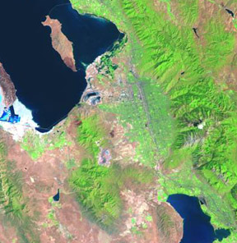
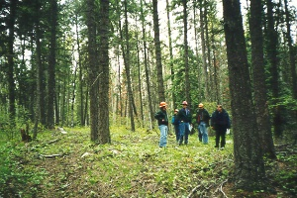
Levels of Use Cases
A common challenge is identifying use cases at a useful goal level.
For example, how do we know which of these is at a useful level?
Negotiate a Supplier Contract
Rent Videos
Log In
Start Up

Slide 8
GUIDELINES: EBP for Use Case Levels
Cockburn supports the Elementary Business Process (EBP) guideline.
Focus on use cases at the level of EBPs.
“A task performed by one person in one place at one time, in response to a business event, which adds measurable business value and leaves the data in a consistent state.”

Slide 9
GUIDELINES: EBP for Use Case Levels
Naively, can you apply the “boss test” for an EBP?
Boss: “What do you do all day?”
Me: “I logged in!”
Is Boss happy?

Slide 10
GUIDELINES: Size for Use Case Levels
An EBP-level use case usually is composed of several steps, not just one or two.
It isn’t a single step.

Slide 11
Use Case Levels: Applying the Guidelines
Applying the EBP and size guidelines:
Negotiate a Supplier Contract
Rent Videos
Log In
Start Up
The others can also be modeled as use cases.
But, prefer a focus on the EBP level.

Slide 12
Use Case Diagrams
Warning: Don’t spend much time on diagramming.
Use case work means to write text, not draw diagrams

Slide 13
DEFINITION: Fully Dressed Use Cases
Rich notation for detailed analysis.
Shows branching scenarios.
Can include non-functional requirements related to the functional.

Slide 14
EXAMPLE: Fully Dressed
Use Case UC1: Rent Video
Level: User-level goal (EBP level)
Primary Actor: Clerk
Preconditions:
Clerk is identified and authenticated.
Stakeholders and their Interests:
Clerk: Wants accurate, fast entry.
Customer: Wants videos, and fast service with minimal effort.
Accountant: Wants to accurately record transactions.
Marketing: Wants to track customer habits.
. . .

Slide 15
EXAMPLE: Fully Dressed
Main Success Scenario (or Basic Flow or “Happy Path”):
Customer arrives at a checkout with videos or games to rent.
Clerk enters Customer ID.
Clerk enters rental identifier.
System records rental line item and presents item description.
(Clerk repeats steps 3-4 until indicates done.)
System displays total.
Customer pays. System handles payment.
Clerk requests rental report.
System outputs it. Clerk gives it to Customer.
Customer leaves with rentals and report.

Slide 16
EXAMPLE: Fully Dressed
Extensions (or Alternatives):
a*. At any time, System fails:
Clerk restarts System
logs in
requests recovery from prior state
1a. New Customer.
1. Perform use case Manage Membership.
2a. Customer ID not found.
1. Cashier verifies ID. If entry error, reenter, else Manage Membership.
2b. Customer has unpaid fines (usually for late returns).
1. Pay Fines.

Slide 17
EXAMPLE: Fully Dressed
Special Requirements:
Language internationalization on the display messages and rental report.
Large text on display. Visible from 1 m.
Technology and Data Variations:
ID entries by bar code scanner or keyboard.
Frequency:
Near continuous
Open Issues:
Should we support a magnetic stripe cards for customer ID, and allow customer to directly use card reader?

Slide 18
GUIDELINES: Use Case Writing
Start sentence 1 with “<Actor> does <event>”
Customer arrives with videos to rent.
First write in the essential form, and “Keep the UI out.”
Capitalize “actor” names.
…
Clerk enters…
System outputs…

Slide 19
GUIDELINES: Use Case Writing
Terse is good. People don’t like reading requirements ;). Avoid noisy words.
More verbose
…
The Clerk enters…
The System outputs…
Less
…
Clerk enters…
System outputs…

Slide 20
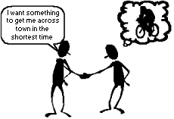
MOTIVATION: Comprehensible & Familiar
Use cases are stories.
A simple and familiar model that many people, especially non-technical, can easily relate to.
iterative requirements use cases sys. sequence diagrams domain models

Slide 21
MOTIVATION: “Requirements in Context”
The subtitle makes an important point:
Use cases bring together related requirements.
More cohesion and context for related requirements.

Slide 22
Artifacts in the UP Use-Case Model
iterative requirements use cases sys. sequence diagrams domain models

Slide 23
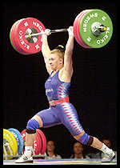
In small teams at the white board, write a fully dressed use case for Process Sale.
Review and apply the guidelines.

