Slide 1
Introduction to Java FX
Slides from book: Introduction to Java Programming, 11-th edition. Y. Daniel Liang

Slide 2
JavaFX vs Swing vs AWT
Section 14.2

Slide 3
JavaFX vs Swing vs AWT
Java was first released with GUI support in something called the Abstract Windows Toolkit (AWT)
AWT was replaced by a new library called Swing
Notes:
AWT wasn’t bad, but it had some limitations, and some particular problems with how it was implemented on some platforms

Slide 4
JavaFX vs Swing vs AWT
Swing was designed primarily for use in desktop applications
Swing has now been replaced by a completely new GUI library called JavaFX
You can still use Swing
Java has replaced Swing with JavaFX
How long until JavaFX is replaced by something else? Nobody knows; probably many years
Notes:
(for the foreseeable future), but Oracle isn’t going to develop it any further – it’s essentially a dead-end technology

Slide 5
JavaFX vs Swing vs AWT
JavaFX lets us write RIAs (Rich Internet Applications)
run under a browser (IE / FireFox / Chrome / Safari)
Previously, the cross-platform (desktop vs browser) experience was delivered by Java Applets, but applets are pretty much dead, too.
Notes:
If you need to learn Swing, see Liang’s 9e, and I will provide lecture slides; otherwise, just learn JavaFX, and don’t look back.

Slide 6
The Basic Structure of a JavaFX Program
Section 14.3

Slide 7
JavaFX Programs: Basic Structure
public class MyProgram { // Body of class }
Becomes:
import javafx.application.Application;
…
public class MyProgram extends Application { // Body of class }

Slide 8
Our First JavaFX Program
First, the result, and then the code:

Slide 9
§14.3: Our First JavaFX Program
import javafx.application.Application;
import javafx.scene.Scene;
import javafx.scene.control.Button;
import javafx.stage.Stage;
public class MyJavaFX extends Application
{
@Override // Override the start method in the Application class
public void start(Stage primaryStage)
{
// Create a scene and place a button in the scene
Button btOK = new Button("OK"); // create a button
Scene scene = new Scene(btOK, 200, 250); // create a scene WITH the button
primaryStage.setTitle("MyJavaFX"); // Set the stage title
primaryStage.setScene(scene); // Place the scene in the stage
primaryStage.show(); // Display the stage
}
/**
* The main method is only needed for the IDE with limited
* JavaFX support. Not needed for running from the command line.
*/
public static void main(String[] args)
{
Application.launch(args);
}
}
Eclipse DOES have enough JavaFX support for us to not need main(). You can completely comment-out (or delete) main(), and this code runs exactly the same under Eclipse

Slide 10
Our First JavaFX Program
JavaFX programs are based on the analogy of a stage (think “theater stage”).
On the stage are scenes
Think theater: scene’s set will have:
actors,
props,
backdrops,
lighting, etc.
In JavaFX, we create the components, add them to scenes, and then add scenes to the stage
Notes:
On the stage are scenes, and each scene is also made up of other components.
On a theater stage, the stage may be divided into portions, where individual scenes take place.
Each scene’s set will have actors, props, backdrops, lighting, etc.
In JavaFX, we create the components, add them to scenes, and then add scenes to the stage

Slide 11
Our First JavaFX Program
In JavaFX, the stage is the window our code runs in
Our applications are not limited to a single stage
Notes:
Since every GUI application, by definition, involves a window with the UI, we get the primaryStage by default when the application launches.
Just as a music festival may have simultaneous performances on multiple stages, we can have more than one stage (window) in our programs.

Slide 12
Our First JavaFX Program
import javafx.application.Application;
import javafx.scene.Scene;
import javafx.scene.control.Button;
import javafx.stage.Stage;
public class MultipleStageDemo extends Application
{
@Override // Override the start method in the Application class
public void start(Stage primaryStage)
{
// Create a scene and place a button in the scene
Scene scene = new Scene(new Button("OK"), 200, 250);
primaryStage.setTitle("MyJavaFX"); // Set the stage title
primaryStage.setScene(scene); // Put the scene in the stage
primaryStage.show(); // Display the stage
Stage stage = new Stage(); // Create a new stage
stage.setTitle("Second Stage"); // Set the stage title
// Set a scene with a button in the stage
stage.setScene(new Scene(new Button("New Stage"), 100, 100));
stage.show(); // Display the stage
}
}

Slide 13
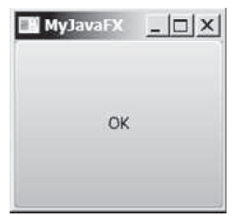
§14.3: Our First JavaFX Program
By default, stages (windows) are resizeable.
Note that we have minimize and maximize buttons
Notes:
If we want our stage to be of fixed size (i.e., not resizeable), we can set that property with stage.setResizeable(false)

Slide 14
Panes, UI Controls, and Shapes
Section 14.4

Slide 15
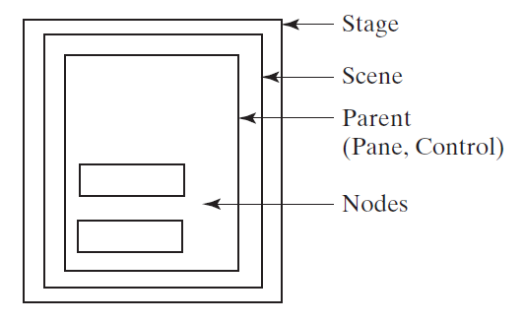
Panes, UI Controls, and Shapes
One approach is to specify the size and location of each UI element (like the buttons)
A better solution is to put the UI elements (known as nodes) into containers called panes, and then add the panes to the scene.

Slide 16
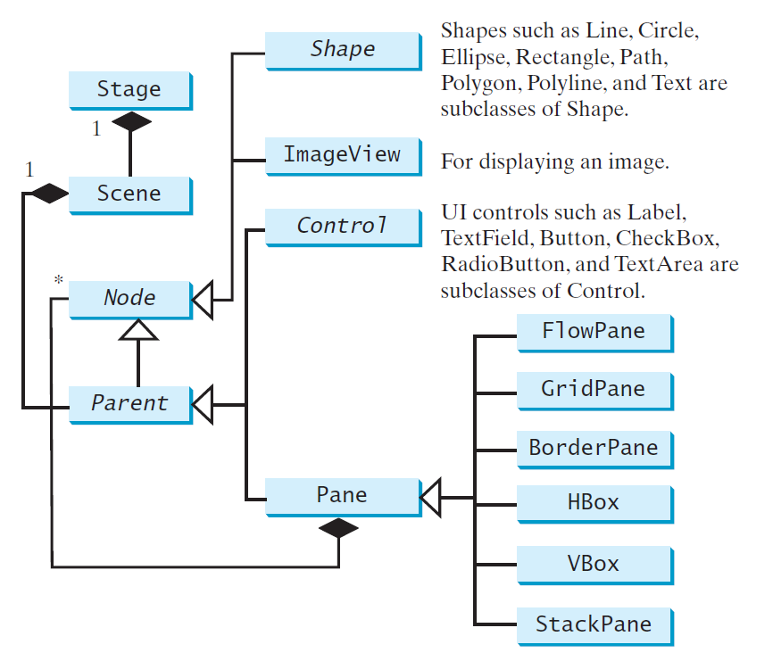
Panes, UI Controls, and Shapes
Notes:
Panes can even contain other panes:

Slide 17
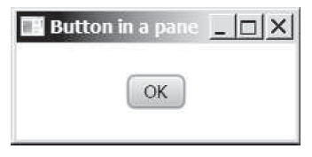
§14.4: Panes, UI Controls, and Shapes
The following slide shows the code to create this version of the same UI, with a single button inside a pane.
It uses a StackPane
Notes:
(which we’ll discuss later).
In order to add something to a pane, we need to access the list of things IN the pane, much like an ArrayList.
The new item we’ll add will be a new child of the pane, so we’re adding it to the list of the pane’s children

Slide 18
Panes, UI Controls, and Shapes
import javafx.application.Application;
import javafx.scene.Scene;
import javafx.scene.control.Button;
import javafx.stage.Stage;
import javafx.scene.layout.StackPane;
public class ButtonInPane extends Application
{
@Override // Override the start method in the Application class
public void start(Stage primaryStage)
{
StackPane pane = new StackPane(); // Make a pane to work with
// create a new button, and add it to the pane’s list of children
pane.getChildren().add(new Button("OK"));
// Make a new scene, containing the pane
Scene scene = new Scene(pane, 200, 50);
primaryStage.setTitle("Button in a pane"); // Set the stage title
primaryStage.setScene(scene); // Put scene in the stage
primaryStage.show(); // Display the stage
}
}

Slide 19
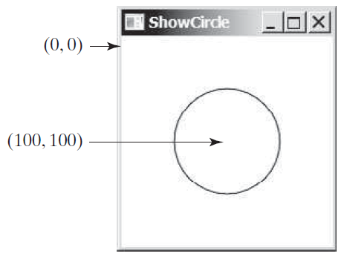
§14.4: Panes, UI Controls, and Shapes
Beyond the obvious, typical “active” UI elements (things we can interact with, like buttons, etc.), are static shapes – lines, circles, etc.
Notes:
Before we can do much with shapes, we have to talk about coordinates within a pane.
The top-left corner of a scene is always (0, 0), and the (positive) X-axis goes to the right, and the (positive) Y-axis goes down. Visually, we’re in Cartesian quadrant IV, but Y stays positive.
All coordinates are in pixels

Slide 20
Panes, UI Controls, and Shapes
import javafx.application.Application;
import javafx.scene.Scene;
import javafx.scene.layout.Pane;
import javafx.scene.paint.Color;
import javafx.scene.shape.Circle;
import javafx.stage.Stage;
public class ShowCircle extends Application
{
@Override // Override the start method in the Application class
public void start(Stage primaryStage)
{
// Create a circle and set its properties
Circle circle = new Circle();
circle.setCenterX(100);
circle.setCenterY(100);
circle.setRadius(50);
circle.setStroke(Color.BLACK);
circle.setFill(Color.WHITE);
// Create a pane to hold the circle
Pane pane = new Pane();
pane.getChildren().add(circle);
// Create a 200-x-200 scene from the pane, and place the scene in the stage
Scene scene = new Scene(pane, 200, 200);
primaryStage.setTitle("ShowCircle"); // Set the stage title
primaryStage.setScene(scene); // Place the scene in the stage
primaryStage.show(); // Display the stage
}
}

Slide 21
Property Binding
Section 14.5

Slide 22
§14.5 Property Binding
In the previous example, the (x, y) location of the center of the circle was static – it will always be located at (100, 100).
What if we want it to be centered in the pane, such that if we re-size the window, the circle will move to stay centered?
This is what property binding is all about
Notes:
In order to do so, the circle’s center has to be bound to the pane’s height and width, such that a change to the height or width will force a change to the x or y value of the circle’s center.

Slide 23
Property Binding
public class ShowCircleCentered extends Application
{
@Override // Override the start method in the Application class
public void start(Stage primaryStage)
{
// Create a pane to hold the circle
Pane pane = new Pane();
// Create a circle and set its properties
Circle circle = new Circle();
circle.centerXProperty().bind(pane.widthProperty().divide(2));
circle.centerYProperty().bind(pane.heightProperty().divide(2));
circle.setRadius(50);
circle.setStroke(Color.BLACK);
circle.setFill(Color.WHITE);
pane.getChildren().add(circle); // Add circle to the pane
// Create a scene and place it in the stage
Scene scene = new Scene(pane, 200, 200);
primaryStage.setTitle("ShowCircleCentered"); // Set the stage title
primaryStage.setScene(scene); // Put scene in stage
primaryStage.show(); // Display the stage
}
}

Slide 24
Property Binding
The target listens for changes in the source and updates itself when the source changes
Remember, the binding syntax is target.bind(source);
Notes:
Realize that with a setter, we specify a value; with binding, we specify the property itself, rather than the value of the property
That’s why we have to use the special methods .add, .subtract, .multiply, and .divide, rather than the numeric operators; the methods return property objects, rather than numeric values (see p.543).

Slide 25
Property Binding
A pair of simple double property objects (not double values) are created with different values, and then one is bound to the other
Their values are printed out (showing that they are different), the value of one is changed, and then they are both printed again, showing that changing one changed the other.
See next slide

Slide 26
§14.5 Property Binding
import javafx.beans.property.DoubleProperty;
import javafx.beans.property.SimpleDoubleProperty;
public class BindingDemo
{
public static void main(String[] args)
{
DoubleProperty d1 = new SimpleDoubleProperty(1);
DoubleProperty d2 = new SimpleDoubleProperty(2);
d1.bind(d2);
System.out.println("d1 is " + d1.getValue()
+ " and d2 is " + d2.getValue());
d2.setValue(70.2);
System.out.println("d1 is " + d1.getValue()
+ " and d2 is " + d2.getValue());
}
}

Slide 27
Common Properties and Methods for Nodes
Section 14.6

Slide 28
§14.6 Common Node Properties & Methods
Nodes share many common properties
This section introduces two – style and rotate
JavaFX style properties are a lot like CSS (Cascading Style Sheets) use to specify styles in HTML (Web) pages.
Thus, it’s known as JavaFX CSS

Slide 29
Common Node Properties & Methods
import javafx.application.Application;
import javafx.scene.Scene;
import javafx.scene.control.Button;
import javafx.stage.Stage;
import javafx.scene.layout.StackPane;
public class NodeStyleRotateDemo extends Application
{
@Override // Override the start method in the Application class
public void start(Stage primaryStage)
{
// Create a scene and place a button in the scene
StackPane pane = new StackPane();
Button btOK = new Button("OK");
btOK.setStyle("-fx-border-color: blue;"); // create blue-bordered button
pane.getChildren().add(btOK);
pane.setRotate(45); // rotate pane and set its style before adding to scene
pane.setStyle("-fx-border-color: red; -fx-background-color: lightgray;");
Scene scene = new Scene(pane, 200, 250);
primaryStage.setTitle("NodeStyleRotateDemo"); // Set the stage title
primaryStage.setScene(scene); // Place the scene in the stage
primaryStage.show(); // Display the stage
}
}

