Slide 1
Handling sensitive data
Dr. X

Slide 2
Outline
What is ”sensitive data”?
Hashing
Encryption

Slide 3
What is “sensitive data”?
Personal Information
Protected Health Information, as defined by the Health Insurance Portability and Accountability Act of 1996 (HIPAA)
Student education records, as defined by the Family Educational Rights and Privacy Act (FERPA)
Customer record information, as defined by the Gramm Leach Bliley Act (GLBA)
Card holder data, as defined by the Payment Card Industry (PCI) Data Security Standard
Confidential personnel information, as defined by the State Personnel Act
Information that is deemed to be confidential

Slide 4
Passwords
Speak “friend” and enter
Problems?
Use
Disclosure
Revocation
Loss
Notes:
Usability: a password for each access is inconvenient
Disclosure: if you share it, it is not secret anymore
Revocation: lock someone out of their account… don’t even think about doing this to your professor
Loss: should we be able to recover password? How are these recovered nowadays?

Slide 5
Password vulnerabilities
No password
Same as UID
From common word list
Contained in a short college dictionary
Contained in complete English word list
Contained in common non-English-language dictionaries
Contained in short college dictionary with capitalizations, substitutions etc.
Contained in complete English dictionary with capitalizations, substitutions etc.
Contained in common non-English-language dictionaries with capitalizations, substitutions etc.
Obtained by brute force using alphanumeric characters
Obtained by brute force using all characters

Slide 6
Common passwords
Lorrie Faith Cranor, CMU

Slide 7
How NOT to store a password?
Plaintext
Encrypt
Just hash

Slide 8
Hash Functions
Hash function h: deterministic one-way function that takes as input an arbitrary message M (sometimes called a preimage) and returns as output h(M), a small fixed length hash (sometimes called a digest)
Hash functions should have the following two properties:
compression: reduces arbitrary length string to fixed length hash
ease of computation: given message M, h(M) is easy to compute
Notes:
openssl speed sha
Used for both digital signatures and password saving
Message digest
Can also be used for non-repudiation, authenticity, correctness

Slide 9
Hashing
http://www.unixwiz.net/techtips/iguide-crypto-hashes.html
Notes:
Certain number of characters
HAS TO BE IRREVERSIBLE!
A "hash" (also called a "digest", and informally a "checksum") is a kind of "signature" for a stream of data that represents the contents. The closest real-life analog we can think is "a tamper-evident seal on a software package": if you open the box (change the file), it's detected.
We will learn more about different hashing algorithms in the protection part of passwords!

Slide 10
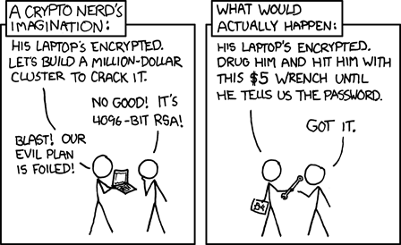
Password Attacks
Guess
Dictionary
Rainbow tables
Notes:
Dictionary: a set of words, hash these, compare with what you have
Rainbow tables: have the hashed table, saves time

Slide 11
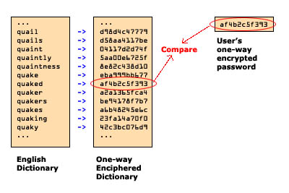
Dictionary attacks
John the Ripper
Hashcat
Hydra
Notes:
Rockyou
Crackstation
This is kinda slow, hackers can do better

Slide 12
Salt and Pepper
Salt: extra piece of information added to a password, stored in a separate file than your /etc/shadow/password
Date
Username
Random
Pepper: not stored secret, may defined by application
THINK: Q2 Why does salt and pepper add entropy to a password?
Do they help eliminate
Dictionary attacks?
Rainbow table attacks?
Notes:
A password hash function (PHF) takes two inputs: the password, and a salt. The salt is randomly generated when the user picks his password, and it is stored together with the hashed password PHF(password, salt). (What matters is that two different accounts always have different salts, and randomly generating a sufficiently large salt is a good way to have this property with overwhelming probability.) When the user logs in again, the verification system reads the salt from the password database, computes PHF(password, salt), and verifies that the result is what is stored in the database.
Salts prevent for all passwords to be cracked with a single rainbow table. They do not per se prevent password cracking.
Peppers may be stored in code. They add some security

Slide 13
Password protection
Make a better password… please
Good practice: do not use the same password
Store the password properly: hash + salt + pepper
Use a strong hashing algorithm (NOT MD5… please)

Slide 14
Hashing with Java
Download the SHAExample from Oaks, ClassActivities
Read the code and try to understand what it is doing. Use the Java API for reference on the java.security.* libraries
Fill in the rest of the hashes: SHA_256, SHA_384, SHA_512.
What is the difference between hashes?
Which one is the best?
Source: https://howtodoinjava.com/security/how-to-generate-secure-password-hash-md5-sha-pbkdf2-bcrypt-examples/

Slide 15
How do we store personal data?
What if we need to read the data???

Slide 16
Secret Key Crypto

Slide 17
Symmetric and Asymmetric Crypto
• Symmetric crypto: (also called private key crypto)
Alice and Bob share the same key (K=K1=K2)
K used for both encrypting and decrypting
Doesn't imply that encrypting and decrypting are the same algorithm
Also called private key or secret key cryptography, since knowledge of the key reveals the plaintext
• Asymmetric crypto: (also called public key crypto)
Alice and Bob have different keys
Alice encrypts with K1 and Bob decrypts with K2
Also called public key cryptography, since Alice and Bob can publicly post their public keys

Slide 18
DES Round: f (Mangler) Function

Slide 19
AES Encryption Process

Slide 20
Encryption and Message Authenticity

Slide 21
Public Key Crypto (10,000 ft view)
Separate keys for encryption and decryption
Public key: anyone can know this
Private key: kept confidential
Anyone can encrypt a message to you using your public key
The private key (kept confidential) is required to decrypt the communication
Alice and Bob no longer have to have a priori shared a secret key

Slide 22
Public Key Cryptography
Each key pair consists of a public and private component: k+ (public key), k- (private key) D_{k-} (E_{k+} (m)) = m
Public keys are distributed (typically) through public key certificates
Anyone can communicate secretly with you if they have your certificate

Slide 23
Encrypting with Java! java.crypto.cipher
Java.crypto.cipher

Slide 24
Encrypting with Java! java.crypto.cipher
https://stackoverflow.com/questions/1205135/how-to-encrypt-string-in-java

Slide 25
Let’s encrypt!
Write a Java program that takes as input a string and then it encrypts and saves the string in a file.
Use AES to encrypt.
How will you save the key for AES?

