Slide 1
Testing & Security
Dr. X

Slide 2
Integer Error
Integer Overflow/Underflow: Mathematical operations can increase integer values above the maximum or decrease them below the minimum allowed values.
Truncation: If an integer is converted from a larger type to a smaller type (say, from a long to a short), the value will be truncated if it is outside the range of the smaller type; data that can't fit will simply be thrown out.
Notes:
nteger Overflow/Underflow: Mathematical operations can increase integer values above the maximum or decrease them below the minimum allowed values. For instance, if i = Integer.MAX_VALUE, the increment operator i++ will cause an overflow and the resulting value will be the smallest possible integer value Integer.MIN_VALUE. Addition, subtraction, multiplication, and even division can cause overflow/underflow problems.
Truncation: If an integer is converted from a larger type to a smaller type (say, from a long to a short), the value will be truncated if it is outside the range of the smaller type; data that can't fit will simply be thrown out. For example, if you have a long variable that has a value that is greater than the largest value that can be stored in a short (long l=32800), assigning the long to a short (short s = (short)l;) will cause a truncation error (s=-32736).

Slide 3
Avoiding Integer Error
Know your bounds
Validate your inputs!

Slide 4
Input Validation
Think about inputs that
can break this program

Slide 5
Input Validation
Check your input:
  Type: data type.
  Range: Verify that numbers are within a range
  Plausibility: Check that values make sense
  Presence check: Guarantee presence of important data
  Length: Input that is either too long or too short will not be legitimate
  Format: Dates, credit card numbers, and other data types have limitations on the number of digits and any other characters used for separation
Checksums
Use appropriate language tools
Recover Appropriately
Notes:
Checksums: Identification numbers such as bank accounts, often have check digits: additional digits included at the end of a number to provide a verifiability check. The check digit is determined by a calculation based on the remaining digits – if the check digit does not match the results of the calculation,either the ID is bad or the check digit is bad. In either case, the number should be rejected as invalid.
Use appropriate language tools: The safety of tools that read user input varies across programming languages and systems. Some languages, such as C and C++ have library calls that read user input into a character buffer without checking the bounds of that buffer, causing a both a buffer overflow and an input validation problem. Alternative libraries specifically designed with security in mind are often more robust.
Recover Appropriately: A robust program will respond to invalid input in a manner that is appropriate, correct, and secure. For user input, this will often mean providing an informative error message and requesting re-entry of the data. Invalid input from other sources – such as a network connection – may require alternate measures. Arbitrary decisions such as truncating or otherwise reformatting data to “make it fit” should be avoided

Slide 6
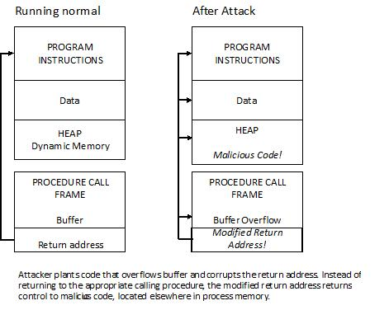
Buffer Overflow

Slide 7
Buffer Overflow

Slide 8
Avoiding Buffer Overflow
Mind your indices!
Make sure you have enough space
Use alternative data structures that reduce the risk of overflows
Try to avoid allocating storage until you know how much you need
Send the size of the array along with the array
Avoid risky functions
Use your tools
Handle exceptions with care
Notes:
Mind your indices!
Validate your input. Always check values that are input as an array index.
Check your loops! Especially watch the limit, beware of off-by-one errors.
Check any methods that may modify an array index.
Make sure you have enough space: Before copying data to a fixed size block, make sure it is large enough to hold the new data. Do not copy more data than your available space can hold.
Validate indices: If you have an integer variable, declare it as an unsigned int and verify that it is within the proper bounds before you use it as an index to an array. This validation is particularly important for any values that might have come from untrusted sources such as user input, network data, or untrusted files.
When possible, use buffer-size accessors: Some languages—such as Java—provide operators that can be used to retrieve the size of an array. Using these operators can help you avoid buffer overflow.
Use alternative data structures that reduce the risk of overflows: When possible, use vectors and iterators instead of arrays and integer-indexed loops. These tools will not eliminate the problem, but will greatly reduce the risk of buffer overflow.
Try to avoid allocating storage until you know how much you need: When possible, wait to allocate memory until after you know how much space you need. In some cases, this may mean allocating a new buffer instead of reusing an old one.
Send the size of the array along with the array: If you’re using an array as an argument to a function, be sure to send the size of the array to the function as well. This value can be used as an upper limit on array indices.
Avoid risky functions: Some languages have a variety of library functions that may lead to buffer overflow vulnerabilities. If you are using any library functions for reading user data, copying data, or allocating/freeing blocks of data, understand the appropriate uses of these functions. In many cases, more secure versions of risky functions are available—use these instead.
Use your tools: Many compilers provide warnings in cases of potential buffer overflows. Use high warning settings, and fix your code to avoid these warnings. Use static analysis tools to analyze your source coda or use dynamic analysis tools to examine and report on the state of your program while running.
Handle exceptions with care: Checking for and responding to potential overflows in your code, instead of relying on the exception-handling mechanism, will make your code more robust and secure.

Slide 9
Resources
https://www.owasp.org/index.php/OWASP_Secure_Coding_Practices_Checklist
https://www.securecoding.cert.org/confluence/display/seccode/Top+10+Secure+Coding+Practices
https://en.wikipedia.org/wiki/Secure_coding

