Slide 1
Social Engineering
Dr. X

Slide 2
Outline
Sigfree by Louis!
Q&A buffer overflow homework
SE framework
SANS Securing the human, by William

Slide 3
What is Social Engineering?

Slide 4
A Quote from Kevin Mitnick
“You could spend a fortune purchasing technology and services from every exhibitor, speaker and sponsor at the RSA Conference, and your network infrastructure could still remain vulnerable to old-fashioned manipulation.”

Slide 5
Types of “hackers” according to Kevin Mitnick
Crackers (or vandals)
Script kiddies
Phone phreaks
Social engineers

Slide 6
A Classic (and real) Example
Stanley Mark Rifkin defrauded the Security Pacific National bank in LA in 1978
Managed to steal $10,200,000 in a single social engineering attack

Slide 7
Types of Attacks
Phishing
Impersonation on help desk calls
Physical access (such as tailgating)
Shoulder surfing
Dumpster diving
Stealing important documents
Fake software
Trojans

Slide 8
Phishing
Use of deceptive mass mailing
Can target specific entities (“spear phishing”)
Prevention:
Honeypot email addresses
Education
Awareness of network and website changes

Slide 9
Impersonation on help desk calls
Calling the help desk pretending to be someone else
Usually an employee or someone with authority
Prevention:
Assign pins for calling the help desk
Don’t do anything on someone’s order
Stick to the scope of the help desk

Slide 10
Physical access
Tailgating
Ultimately obtains unauthorize building access
Prevention
Require badges
Employee training
Security officers
No exceptions!

Slide 11
Shoulder surfing
Someone can watch the keys you press when entering your password
Probably less common
Prevention:
Be aware of who’s around when entering your password

Slide 12
Dumpster diving
Looking through the trash for sensitive information
Doesn’t have to be dumpsters: any trashcan will do
Prevention:
Easy secure document destruction
Lock dumpsters
Erase magnetic media

Slide 13
Stealing important documents
Can take documents off someone’s desk
Prevention:
Lock your office
If you don’t have an office: lock your files securely
Don’t leave important information in the open

Slide 14
Fake Software
Fake login screens
The user is aware of the software but thinks it’s trustworthy
Prevention:
Have a system for making real login screens obvious (personalized key, image, or phrase)
Education
Antivirus (probably won’t catch custom tailored attacks)

Slide 15
Trojans
Appears to be useful and legitimate software before running
Performs malicious actions in the background
Does not require interaction after being run
Prevention:
Don‘t run programs on someone else’s computer
Only open attachments you’re expecting
Use an antivirus

Slide 16
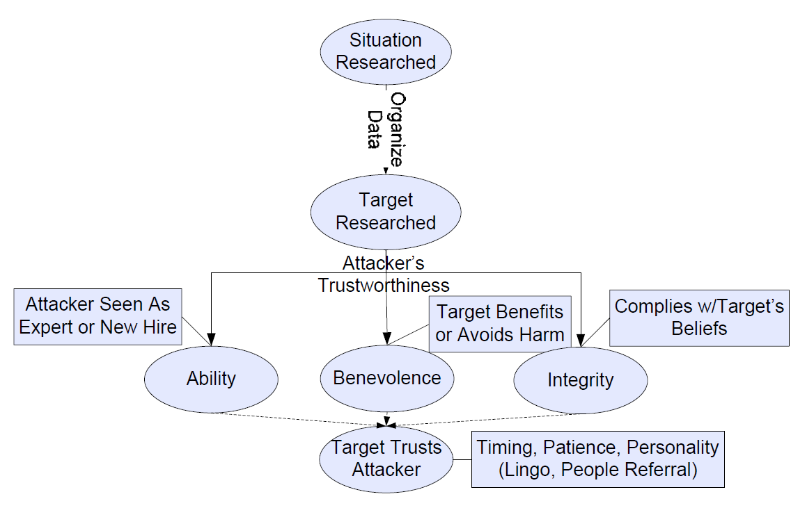
Trust Model

Slide 17
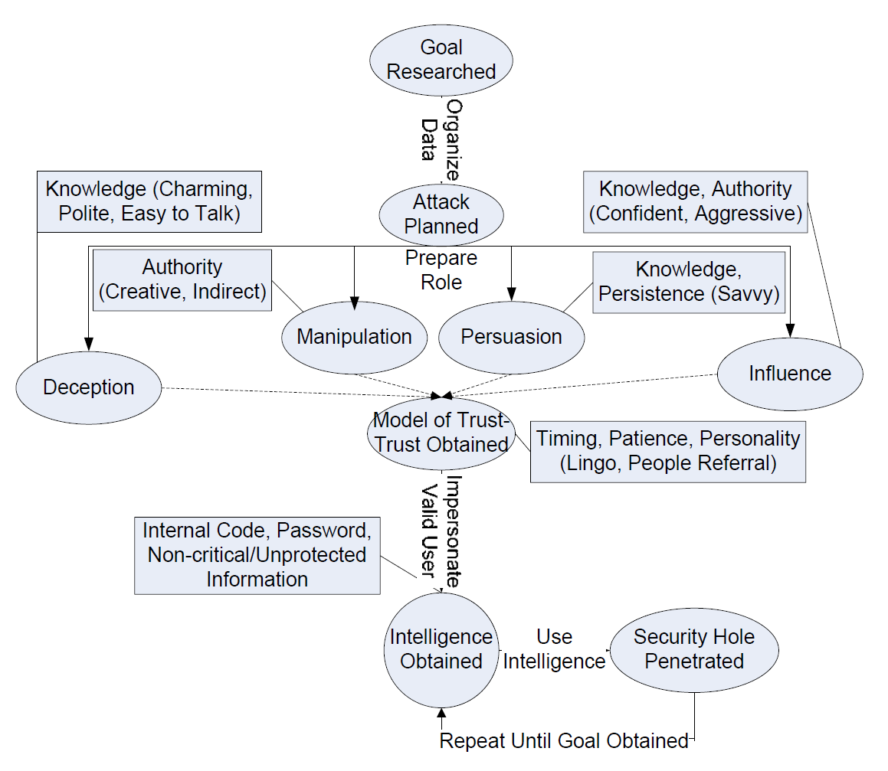
Attack Model

Slide 18
Responding
You’ve been attacked: now what?
Have a place to report incidents
People need to take responsibility
Conduct audits

Slide 19
Other Thoughts
What damage has been done? What damage can still be done?
Has a crime actually taken place?

Slide 20
Sources
Adopted slides by Caleb Leak and Smiti Bhatt
Ch. 5: The basics of Hacking and Penetration Testing
SE Framework: http://www.social-engineer.org/framework/general-discussion/

Slide 21
Comprehension questions
What is social engineering and why should organizations be concerned about it?
Why is social engineering so widely used amongst hackers?
Why do so many people fall victim to social engineering attacks?
When performing onsite social engineering engagements, what are some of the tactics you use that are most likely to result in a compromise?
When performing remote social engineering engagements, what are some of the tactics you use that are most likely to result in a compromise?

Slide 22
Comprehension questions
What are the top five things you suggest an organization do or implement to protect themselves from social engineering threats?
What is the most effective strategy an organization can use to educate employees on social engineering threats and are there any tools available to help?

Slide 23
Discussion Questions
Can we prepare for zero day SE attacks? What would be the process?
Think of SE attacks that are were not included in today’s lecture.
Think of SE defenses that were not discussed.
Can there be insider SE attacks?

