Slide 1
Security Controls
Dr. X

Slide 2
Outline
NIST 800-53
Ahana’s presentation on SANS Security Controls
Conversation on SANS Security Controls
Joey’s & Rich’s project presentation

Slide 3
Definitions
Control Framework: A control framework is a set of controls that protects data within the IT infrastructure of a business or other entity.
Framework: an arrangement of parts that provides a form, or structure, to the whole.

Slide 4
Major players in IT framework arena
AICPA/CICA
Carnegie Mellon University (CMU/SEI) OCTAVE
CICA CoCo – Criteria of Control Framework
CICA IT Control Guidelines
CMMI – Capability Maturity Model Integration
CobiT
COSO
GAISP – Generally Accepted Information Security Principles
ISF Standard of Good Practice for Information Security
ISO 9000
ITIL
Malcolm Baldridge National Quality Program
OECD Principles of Corporate Governance
OPMMM
Six Sigma
Recommended Security Controls for Federal Information Systems, NIST SP 800-53 rev.4
CIS 20 Critical Controls
ISO 17799:2005 and the ISO 27000 series

Slide 5
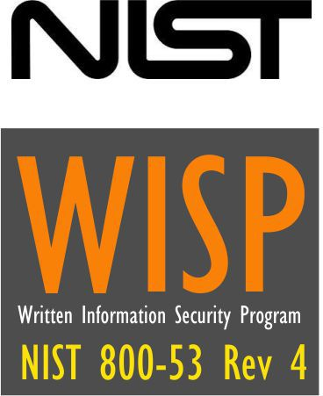

Our focus

Slide 6
NIST 800-53 Rev. 4
Updated to reflect evolving technology and threat space
  Mobile and cloud computing
  Insider threats
  Applications security
  Supply chain risks
  Advanced persistent threat
  Trustworthiness
  Assurance
  Resilience of information systems

Slide 7
NIST 800-53 Rev. 4
Risk Management Framework that addresses security control selection
Selecting an initial set of baseline security controls based on a FIPS 199 worst-case, impact analysis
Tailoring the baseline security controls
Supplementing the security controls, as necessary, based on an organizational assessment of risk.

Slide 8
NIST Risk Management Framework Security Lifecycle
SP 800-37 / SP 800-53A
Continuous Monitoring
Starting Point
FIPS 200 / SP 800-53
CSC Control Tailoring
FIPS 199
MONITOR
Security Controls
CATEGORIZE Information System
SELECT Security Controls
Continuously track changes to the information system that may affect security controls and reassess control effectiveness
Define criticality /sensitivity of information system according to potential impact of loss
Select baseline (minimum) security controls to protect the information system; apply tailoring guidance as appropriate
SP 800-37
Risk Management
SP 800-53 / SP 800-30
Security Center Analysis
AUTHORIZE Information System
SUPPLEMENT Security Controls
Determine risk to agency operations, agency assets, or individuals and, if acceptable, authorize information system operation
Use risk assessment results to supplement the tailored security control baseline as needed to ensure adequate security and due diligence
SP 800-53A
Control Effectiveness Audit
SP 800-17
System Security Plan (SSP)
SP 800-70
CSC Controls Roll out
ASSESS
Security Controls
DOCUMENT Security Controls
IMPLEMENT Security Controls
Determine security control effectiveness (i.e., controls implemented correctly, operating as intended, meeting security requirements)
Document in the security plan, the security requirements for the information system and the security controls planned or in place
Implement security controls; apply security configuration settings

Slide 9
NIST 800-53 Rev. 4
Cornerstone authority for many organizations in US Federal Government
Mainly adopted in US

Slide 10
NIST Publications
FIPS Publication 199 (Security Categorization)
FIPS Publication 200 (Control Family Definitions)
NIST Special Publication 800-30 (Risk Assessment)
NIST Special Publication 800-53 (Recommended Security Controls)
NIST Special Publication 800-53A (Security Control Assessment)
NIST Special Publication 800-60 (Security Category Mapping)
NIST Special Publication 800-137 (Continuous Monitoring)

Slide 11
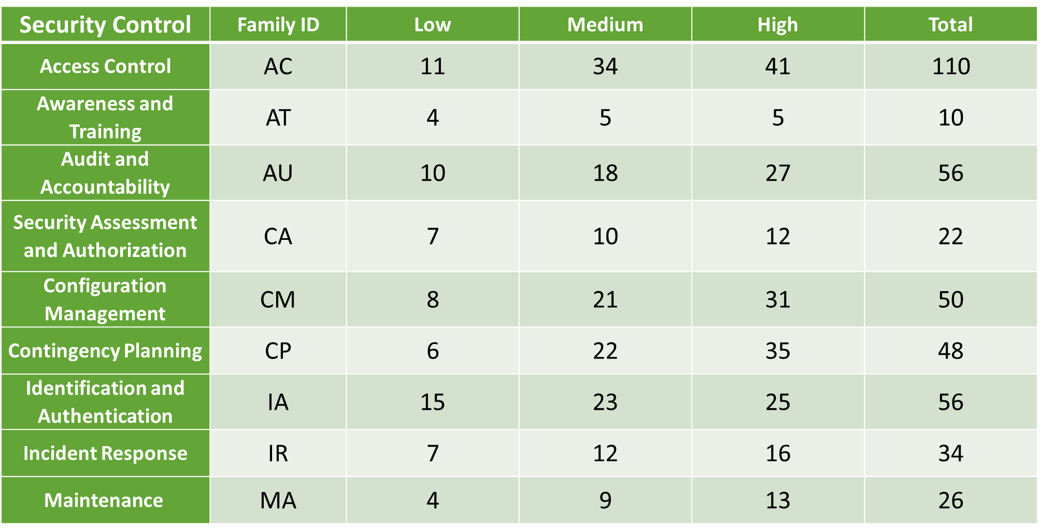
NIST 800-53 Rev. 4 Control Families

Slide 12
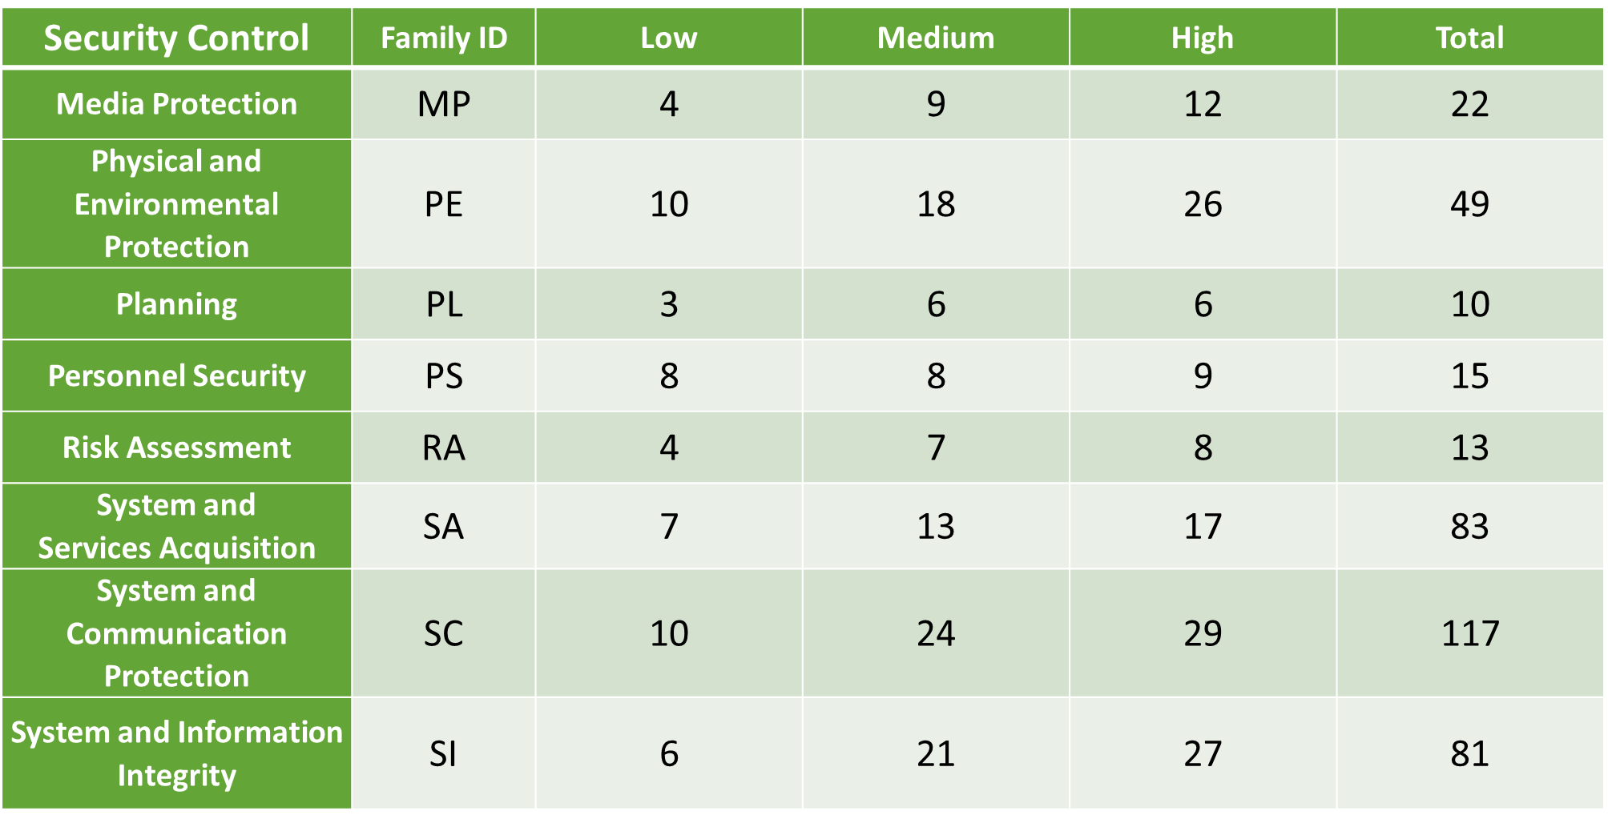
NIST 800-53 Rev. 4 Control Families

Slide 13
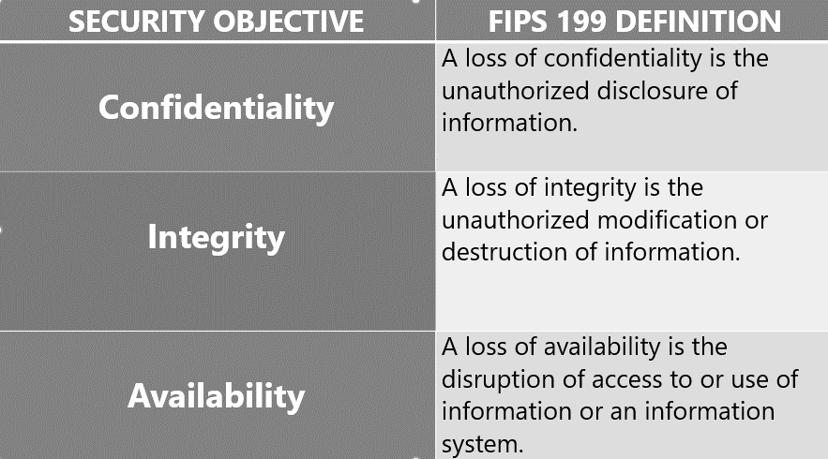

Risk Categorization

Slide 14
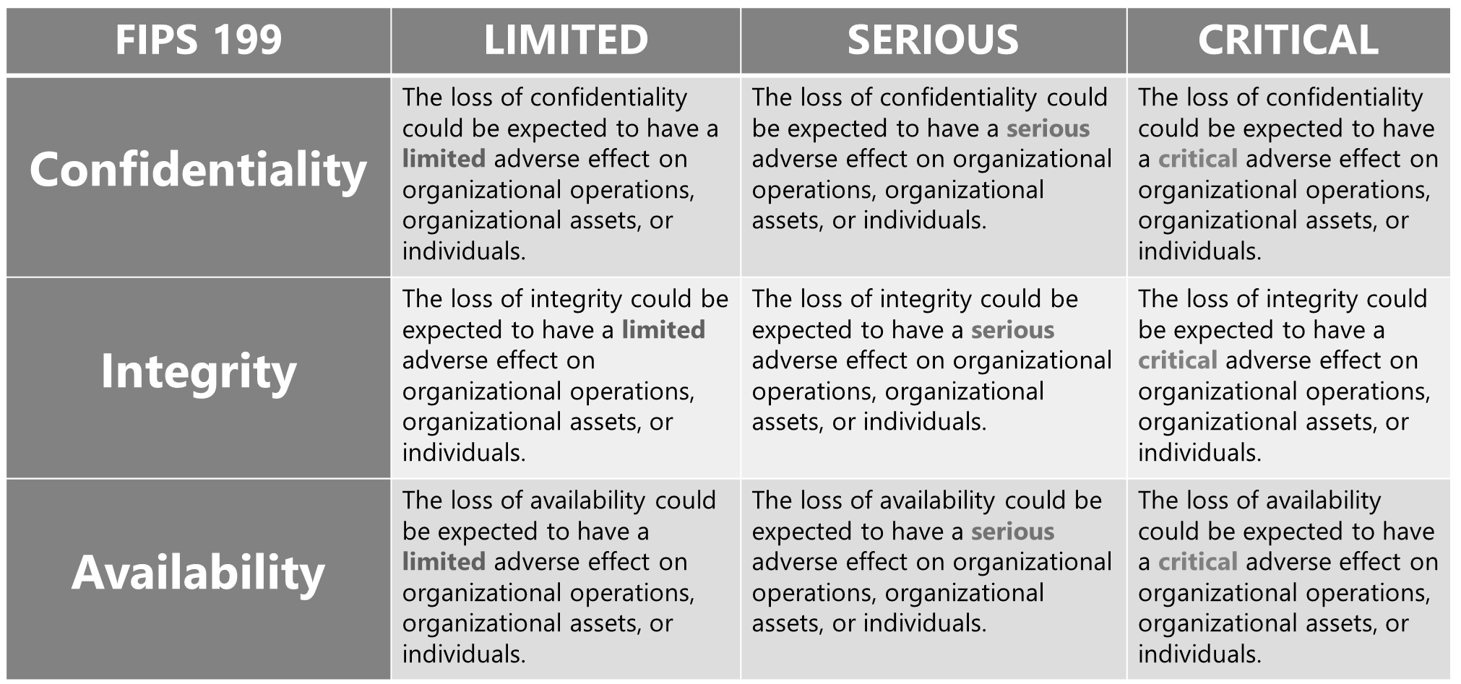
System Categorization and Impact Analysis

Slide 15

Case Study – Higher Education
Project Kick-off January 2015
Project lasted 7 Months
29+ participants including CIO, 5 ACIO’s, ISO, Project Management, and Security, System Engineers, and Support Staff from 6 Teams
SU supplied 123 documents for review (not including web content)
207 organizationally-defined fields completed (55.8%)
217 action items listed in POAM
Phase 1 of control implementation completed at the end of April, 2016 with 2 additional phases in the queue.

Slide 16
Case Study – Higher Education

Slide 17
CIS 20 Critical Controls

Slide 18
Core characteristics of attacks
Target individual
Deliver payload to system
Upload files
Run processes
Survive a reboot
Make outbound connections
Perform internal reconnaissance
Pivot into the network
Notes:
What are the two most dangerous apps out there? Email Clients, Browsers
Block executable attachments

Slide 19
Why sec Controls?
Data drives decisions
Offense must inform defense
Metrics - All controls can be measured!!
Continuous diagnostics & mitigation
Automation

Slide 20
Traditional threats and how to fight those
Desktop AV – signature, behavior
IPS – attack signature based detection
Firewalls – block IP, port connections, pure network level logic
Secure web gateways – script based malware analysis

Slide 21
Advanced Targeted Attack
Stealthy
Zero day
Targeted
Persistent

Slide 22
Detecting modern malware
Continuous monitoring of system
Continuous monitoring of network
Automated mechanisms to discover C&C

Slide 23
Control intents
Proactively detect intrusions
Reduce risk of targeted cyber intrusion
Reduce damage from successful targeted cyber intrusions
Increase the cost and effort of intrusions for adversaries

Slide 24
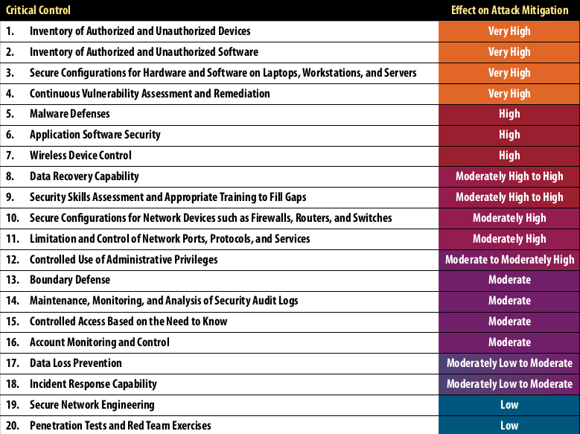
SANS top 20
Notes:
Why are these prioritized? Do you agree with the prioritization?
Developed by community of experts
Focus on attack patterns, not security risk assessment
Small, actionable, measurable controls
California recommends their usage: https://oag.ca.gov/breachreport2016

Slide 25
Strengths
Prioritized
Measurable
Notes:
But what should we measure in terms of adding value to security decisions?

Slide 26
Weaknesses
Lacking in some areas – Physical Controls
Lacking in regulatory compliance

Slide 27
Inventory of Devices
Authorized & Unauthorized
Reduce the ability of attackers to find and exploit unauthorized and unprotected systems
  Active monitoring
  Configuration management
  Up-to-date device inventory on the network
    Servers, workstations
    Routers, remote devices

Slide 28
Secure Configurations
Prevent attacks from exploiting services and settings that allow easy access through networks and browsers
  Standard secure machine images
      On all new systems deployed in the enterprise
      Follows best practices
  Hosted on secure servers
  Regularly validated and updated
  Configurations tracked

Slide 29
Vulnerability Assessment
Positively identify and repair software vulnerabilities reported by researchers and vendors
  Continuous vulnerability assessment
  Continuous remediation
  Use automated scanning tools
  Fix problems within 48 hours

Slide 30
Malware Defenses
Block malicious code from altering system settings or contents, capturing data or spreading
  Anit-virus anti-spyware software
  Continuous scanning
  Automatically updated daily
  Disable auto-run on network devices

Slide 31
Application Software Security
Neutralize vulnerabilities in web-based and other application software
  Carefully test all application software for security flaws .
      Coding errors, malware
  Deploy web application firewalls (modsecurity)
      Inspect all traffic
      Explicitly check user input errors (size and data type)

Slide 32
Wireless Device Control
Protect against unauthorized wireless access
  Allow wireless access provided:
      The device matches an authorized config
      Authhorized security profile
      Has a documented owner and business need
  All access points aare manageable using enterprise tools
  Scanning tools should be able to detect all access points

Slide 33
Data Recovery Capability
Minimize damage from an attack
  Automate back up of all information required
    Full restoration capability of all systems
      Operating systems
      Application software
      Data
  All systems weekly
  Sensitive info daily
  Regularly test restore process

Slide 34
Training and Skills Assessment
Find knowledge gaps and remediate with training and exercises
  Develop a skills assessment program
  Skills required for each job
  Remediate
  Allocate reources

Slide 35
Secure Configurations
Close all holes from forming at connection points to the outside
  Devices: firewalls, routers, and switches
  Compare configurations with best practices
  Document all deviations with appropriate approvals
  All temporary deviations are reversed

Slide 36
Limitation and Control of Network
Remote access permitted only to l egitimatte users and services
  Holes: ports, protocols, and services
  Block everything that is not explicitly allow
  Use host-based firewalls, port-filtering and scanning tools
  Configure services to limit remote remote access
  Disallow automatic software installation
  Move servers behaind the firewall unless required

Slide 37
Controlled Use of Admin Privileges
Protect and validate admin accounts everywhere
  Dissuade users from opening malicious e-mail, attachments or visiting malicious websites
  Robust passwords

Slide 38
Boundary Defense
Control the flow of traffic through network borders, police content looking for attacks
  Establish multilayered boundary defenses
      Firewalls, proxies DMZ
      Perimeter networks
  Filter inbound and outbound traffic

Slide 39
Security Audit Logs
Use logs to identify attacks and uncover details of the attack
  Maintain, monitor and analyze detailed logs
  Logs are standardized as much as possible
  Transactions
  Packets

Slide 40
Access Control
Based on strict need to know basis
  Separate critical data from readily available data
  Establish a multilevel data classification scheme
      Based on impact of data exposure
  Associate data with an owner and permitted users

Slide 41
Account Monitoring
Keep attackers from impersonating legitimate users
  Immediately revoke system access for terminated employees
  Disable dormant accounts
  Use robust passwords

Slide 42
Data Loss Prevention
Prevent unauthorized transfer of data through network attacks and physical theft
  Monitor data movement across network boundaries
  Monitor people, processes, and systems
      Use a centralized management framework
      Removable storage devices

Slide 43
Incident Response Capability
Protect the enterprises information and reputation
  Develop incident response plan
    Roles and rsponsibilities
    Contain the damage
    Eradicating the attackers presence
    Restoring the integrity of the network and systems

Slide 44
Secure Network Engineering
Use robust and secure network engineering discipline
  Three layers
    DMZ
    Middleware
    Private network
  Rapid deployment of new access controls

Slide 45
Penetration Tests
Use simulated attacks to improve organizational readiness
  Penetration tests: internal and expernal
  Use periodic red team exercises
  Test existing defenses
  Test response capabilities

Slide 46
Sources
NIST 800-53: http://nvlpubs.nist.gov/nistpubs/SpecialPublications/NIST.SP.800-53r4.pdf
SANS CIS Critical Security Controls: https://www.sans.org/critical-security-controls

