Slide 1
Advanced Cybersecurity
Dr. X

Slide 2
Logistics
Upcoming deadlines:
  Project proposal Feb. 1
Setup 4 VMS
  Kali,
  XP,
  Metasploitable,
  OWASP vulnerable web apps VMS
Setup two cloud accounts (more on today’s lab)
  Edurange – Amazon WS
  Global Environment for Network Innovations (GENI)

Slide 3
Classroom behavior
Please raise your hand when you have an observation or question.
We need an arbitrated conversation since we have a participation grade.
Please ask up to two follow up questions
  If you have more than two questions, keep a note and I will answer these on an email or office hours

Slide 4
Outline
Presentation and discussion: “Trusting Trust”, Callum Brill
Intrusion Detection Systems

Slide 5
Trusting Trust
Callum Brill

Slide 6
Network Intrusion Detection Systems (NIDSs)
Authorized eavesdropper that listens in on network traffic
Makes determination whether traffic contains malware
  usually compares payload to virus/worm signatures
  usually looks at only incoming traffic
If malware is detected, IDS somehow raises an alert
Intrusion detection is a classification problem

Slide 7
Host Intrusion Detection Systems (HIDSs)
Intrusion detection that takes place on a single host system.
Agent monitors and reports on
  system configuration
  application activity
log analysis, event correlation, integrity checking, policy enforcement, rootkit detection, and alerting¹. They often also have the ability to baseline a host system to detect variations in system configuration. In specific vendor implementations these HIDS agents also allow connectivity to other security systems.

Slide 8
HIDS and Antivirus
Are they the same?
Do they have differences?
Do they have overlap?
Notes:
Historically speaking: no. An anti-virus primary goal is to detect and block access to malicious files, while and HIPS solution has a broader goal: it may track changes on the file system (to detect changes not necessarily implying any malicious code, like an unexpected settings change for instance), analyze log filess (system and application logs), check the system components to detect any irregularities, and indeed also try to detect potential malware.
An HIPS solution may be either composed of several different software and the anti-virus be only of them, or one may go toward all-in-one solutions where a single tool will bundle all these functions.
The fact is that nowadays end-user's anti-virus are a bit more than simple anti-virus, over time they have accumulated a very large panel of features turning them more into security suites which can be indeed perceived as end-user's HIPS solutions.
A basic anti-virus, whose only goal is to detect and block access to malicious files, is only a part of an HIPS solution,
Current end-user's anti-virus go well over this, they are often renamed as security suites and are becoming end-user's HIPS solutions.
http://security.stackexchange.com/questions/109442/what-is-the-difference-between-a-hids-hips-and-an-anti-virus

Slide 9
Example Setup
Notes:
Example setup: the position of the IDS is important!
Where would we position the HIDS? Where do we prefer HIDS vs An

Slide 10
Detection via Signatures
Signature checking: does packet match some signature?
  Payload, e.g., shellcode
  Header, e.g., SYN
Problem: not so great for zero-day attacks -- Q: WHY?

Slide 11
Detection via Machine Learning
Underlying assumption:
  Malware will look different from non-malware
  Anomaly in traffic will look different than regular traffic
Supervised Learning:
  IDS requires learning phase in which operator provides pre-classified training data to learn patterns
  Sometimes called anomaly detection (systems)
  {good, 80, “GET”, “/”, “Firefox”}
  {bad, 80, “POST”, “/php-shell.php?cmd=’rm -rf /’”, “Evil Browser”}
  ML technique builds model for classifying never-before-seen packets
  Problem: is new malware going to look like training malware?

Slide 12
Confusion Matrix
What constitutes an intrusion/anomaly is really just a matter of definition
  A system can exhibit all sorts of behavior
Quality determined by the consistency with a given definition
  Context sensitive

Slide 13
Metrics
True positives (TP): number of correct classifications of malware/anomaly
True negatives (TN): number of correct classifications of non-malware/regular
False positives (FP): number of incorrect classifications of non-malware as malware/anomaly
False negatives (FN): number of incorrect classifications of malware as non-malware/regular
Notes:
False positives are disruptive for businesses. Why?
What is worse, false positive or false negative?

Slide 14
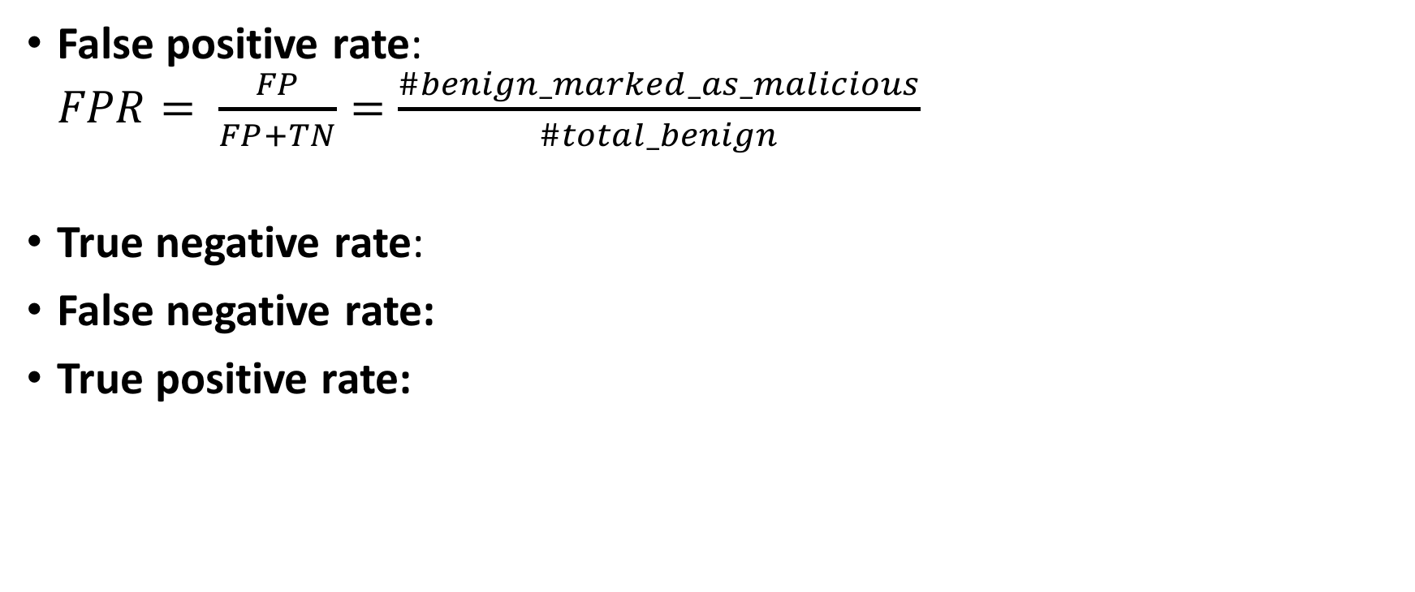
Metrics
False positive rate:
$FPR= \frac{FP}{FP+TN}=\frac{\#benign_marked_as_malicious}{\#total_benign}$
True negative rate:
False negative rate:
True positive rate:
Notes:
Derive the formulas for TNR, FNR, FPR

Slide 15
Base Rate Fallacy
Occurs when we assess P(X|Y) without considering prior probability of X and the total probability of Y
Example:
  Base rate of malware is 1 packet in a 10,000
  Intrusion detection system is 99% accurate (given known samples)
    1% false positive rate (benign marked as malicious 1% of the time)
    1% false negative rate (malicious marked as benign 1% of the time)
  Packet X is marked by the NIDS as malware. What is the probability that packet X actually is malware?
    Let’s call this the “true alarm rate,” because it is the rate at which the raised alarm is actually true.

Slide 16
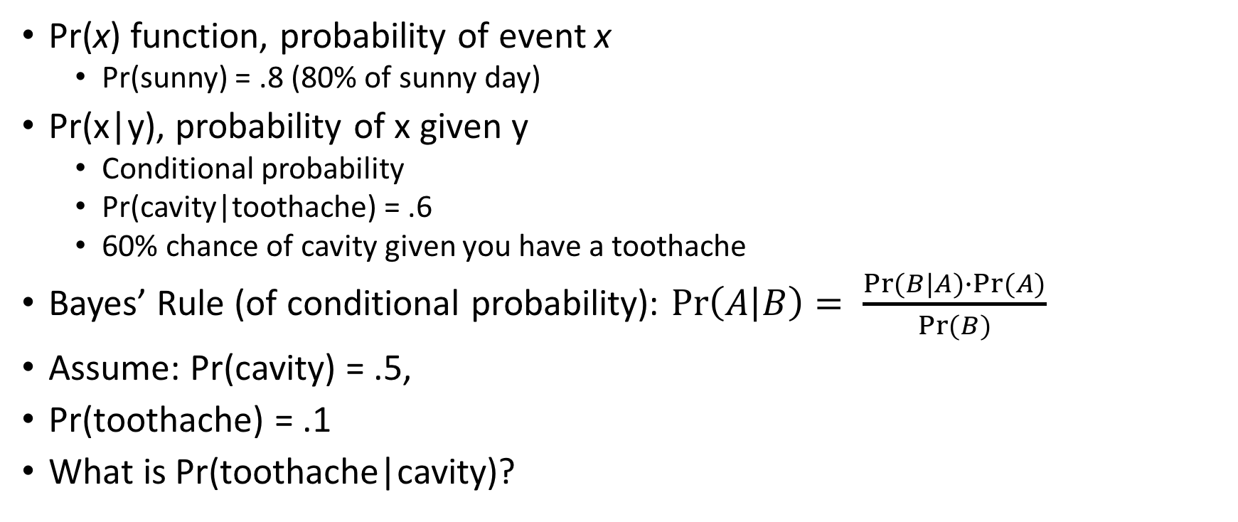
Bayes’ Rule
Pr(x) function, probability of event x
  Pr(sunny) = .8 (80% of sunny day)
Pr(x|y), probability of x given y
  Conditional probability
  Pr(cavity|toothache) = .6
  60% chance of cavity given you have a toothache
Bayes’ Rule (of conditional probability): $\operatorname{Pr}\left(A | B\right)= \frac{Pr⁡(B|A)∙Pr⁡(A)}{Pr⁡(B)}$
Assume: Pr(cavity) = .5,
Pr(toothache) = .1
What is Pr(toothache|cavity)?

Slide 17
Base Rate Fallacy
How do we find a true alarm rate? (Pr[IsMalware | MarkedAsMalware])
We know:
  1% false positive rate (benign marked as malicious 1% of the time); TNR= 99%
  1% false negative rate (malicious marked as benign 1% of the time); TPR= 99%
  Base rate of malware is 1 packet in 10,000
What is?
  Pr(MarkedAsMalware|IsMalware) = ?
  Pr(IsMalware) = ?
  Pr(MarkedAsMalware) = ?

Slide 18
Base Rate Fallacy
How do we find the true alarm rate? [i.e., Pr(IsMalware|MarkedAsMalware)]
Therefore only about 1% of alarms are actually malware!
  What does this mean for network administrators?

Slide 19
Base Rate Fallacy Summary
Let Pr(M) be the probability that a packet is actually malware (thebaserate)
Let Pr(A) be the probability that the IDS raises an alarm (unknown)
Assume we also know for the IDS
  Pr(A|M)=TPR=1-FNR
  Pr(A|!M)=FPR
Then the true alarm rate is
Notes:
Not strong influence of Pr(M)

Slide 20
Where is Anomaly Detection useful?

Slide 21
The Receiver Operating Characteristic Curve (ROC)
Receiver Operating Characteristic (ROC)
  Curve that shows that detection/false positive ratio
  (for a binary classifier system as its discrimination threshold is varied)
Notes:
Axelsson talks about the real problem with some authority and shows how this is not unique to CS
• Medical, criminology (think super-bowl), financial

Slide 22
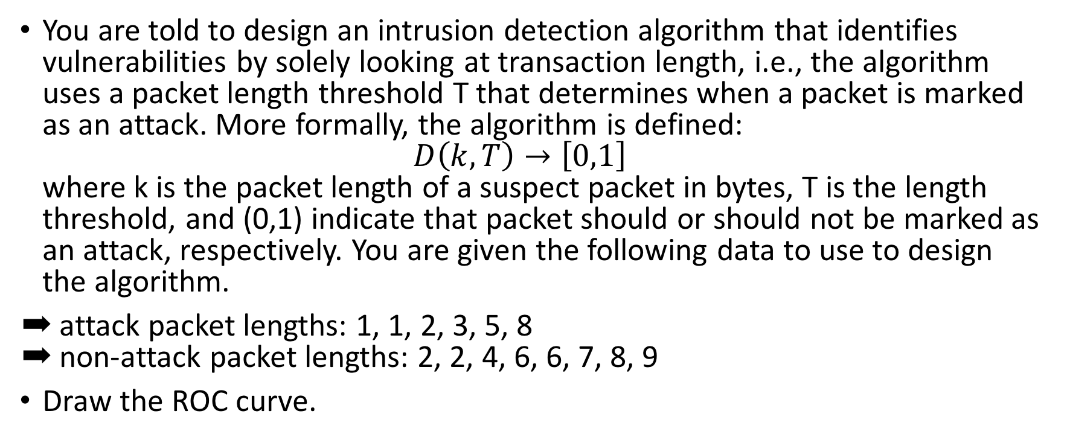
Example ROC Curve
You are told to design an intrusion detection algorithm that identifies vulnerabilities by solely looking at transaction length, i.e., the algorithm uses a packet length threshold T that determines when a packet is marked as an attack. More formally, the algorithm is defined:
$D\left(k, T\right)→\left[0,1\right]$
where k is the packet length of a suspect packet in bytes, T is the length threshold, and (0,1) indicate that packet should or should not be marked as an attack, respectively. You are given the following data to use to design the algorithm.
➡ attack packet lengths: 1, 1, 2, 3, 5, 8
➡ non-attack packet lengths: 2, 2, 4, 6, 6, 7, 8, 9
Draw the ROC curve.

Slide 23
Problems with IDSs
VERY difficult to get both good recall and precision
Malware comes in small packages
Looking for one packet in a million (billion? trillion?)
If insufficiently sensitive, IDS will miss this packet (low recall)
If overly sensitive, too many alerts will be raised (low precision)

Slide 24
Snort
Open source IDS
Signature detection
Lots of available rulesets
alert tcp $EXTERNAL_NET any -> $SQL_SERVERS 3306 (msg:"MYSQL root login attempt"; flow:to_server,established; content:"|0A 00 00 01 85 04 00 00 80|root|00|"; classtype:protocol-command-decode; sid:1775; rev:2;)

Slide 25
How can we study attacks?
Honeypots!
  collection of decoy services (fake mail, web, ftp, etc.)
  decoys often mimic behavior of unpatched and vulnerable services
Notes:
A controlled environment constructed to trick malware into thinking it is running in an unprotected system

Slide 26
Honeypots
Three main uses:
  forensic analysis: better understand how malware works; collect evidence for future legal proceedings
  risk mitigation:
    provide “low-hanging fruit” to distract attacker while safeguarding the actually important services
    tarpits: provide very slow service to slow down the attacker
  malware detection: examine behavior of incoming request in order to classify it as benign or malicious

Slide 27
Honeypots
Low Interaction: emulated services
  inexpensive
  may be easier to detect
High Interaction: noemulation;honeypot maintained inside of real OS
  Expensive
  good realism

Slide 28
Example Honeypot Workflow

Slide 29
Examining malware
Trace system calls:
  most OSes support method to trace sequence of
  system calls e.g., ptrace, strace, etc.
  all “interesting” behavior (e.g., networking, file I/O, etc.) must go through system calls
  capturing sequence of system calls (plus their arguments) reveals useful info about malware’s behavior

Slide 30
Examining malware
Observe filesystem changes and network IO:
  “diff” the filesystem before and after
    which files are the malware reading/ writing?
  capture network packets
    to whom is the malware communicating
Utilize hidden kernel module:
  capture all activity
  challenge: encryption

Slide 31
Challenges
Honeypot must resemble actual machine
  simulate actual services (Apache, MySQL, etc.)
  but not too much... bad form to actually help propagate the worm (legal risks!)
Some worms do a reasonably good job of detecting honeypots

Slide 32
Honeynets
Honeynet: also called honeyfarms
  Collection of honeypots that simulate a network; or
  Single honeypot that emulates services on multiple emulated “machines” (that is, on a network)

Slide 33
Example Deployment

Slide 34
honeyd
Open-source virtual honeynet
  creates virtual hosts on network
  services actually run on a single host
  scriptable services

Slide 35
Internet Background Radiation
Internet Background Radiation or Backscatter: Traffic that is sent to addresses on which no device is set up (these unused portions of the Internet are called darknets)
  Backscatter primarily originates from spam, worms, and port scans
  Estimated at 5.5Gbps
  Estimated that 70% of background radiation due to Conficker Worm

Slide 36
Virtual Machines
Virtual machine: isolated virtual hardware running within a single operating system
  i.e., a software implementation of hardware
  usually provides emulated hardware which runs OS and other applications
  i.e., a computer inside of a computer
What’s the point?
  extreme software isolation -- programs can’t easily interfere with one another if they run on separate machines
  much better hardware utilization than with separate machines
  power savings
  easy migration -- no downtime for hardware repairs/ improvements

Slide 37
Virtual Machines

Slide 38
Honeypots and VMs
Most virtual machines provide checkpointing features
  Checkpoint (also called snapshot) consists of all VM state (disk, memory, etc.)
  In normal VM usage, user periodically creates snapshots before making major changes
  Rolling back (“restoring”) to snapshot is fairly inexpensive
Checkpointing features are very useful for honeypots
  Let malware do its damage
  Pause VM and safely inspect damage from virtual machine monitor
  To reset state, simply restore back to the checkpoint

Slide 39
Detecting VMs
Lots of research into detecting when you’re in a virtual machine
  examine hardware drivers
  time certain operations
  look at ISA support
Malware does this too!
  if not in VM, wreak havoc
  if in VM, self-destruct

Slide 40
Sources
Computer and Network Security, William Enck
S. Axelsson, “The Base-Rate Fallacy and Its Implications for the Difficulty of Intrusion Detection”, in Proceedings of the ACM Conference on Computer and Communication Security, November, 1999

Slide 41
Create cloud accounts: GENI & Edurange

Slide 42
Edurange
Create an account
Go to: https://cloud.edurange.org
Use Registration Code: 8c761f25
You will choose a password for your account on cloud.edurange.org.
When your instructor creates an exercise and places you in a group, you should receive an e-mail with a temporary username and password for that exercise. You can use that to connect via ssh to the public IP address of a gateway for that exercise. In some cases, you may need to ssh from the gateway to a team VM using the same credentials.

Slide 43
GENI
Create an account:
  Windows: http://mountrouidoux.people.cofc.edu/CyberPaths/gettingstarted.html
  Mac: http://mountrouidoux.people.cofc.edu/CyberPaths/gettingstartedmac_vers.html
Join the project CSIS641S17

