Slide 1
Computer Network Security
Dr. X
(Derived from slides by Prof. William Enck, NCSU)

Slide 2
Logistics
Firewall exercise due on Feb. 22
Midterm March 1
Network Attacks
DDoS – Andrew Tye
GENI Registration Troubleshooting and Hello GENI

Slide 3
Outline
Network Attacks
DDoS – Andrew Tye
GENI Registration Troubleshooting and Hello GENI

Slide 4
OSI stack

Slide 5
Networking
Fundamentally about transmitting information between two devices
Communication is now possible between any two devices anywhere (just about)
Lots of abstraction involved (see previous slide)
Lots of network components (routers)
Standard protocols (e.g., IP, TCP, UDP)
Wired and wireless
What about ensuring security?

Slide 6
Network Security

Slide 7
Exploiting the network
The Internet is extremely vulnerable to attack
it is a huge open system ...
which adheres to the end-to-end principle: smart end-points, dumb network
Can you think of any large-scale attacks that would be enabled by this setup?

Slide 8
Network security
The network is ...
a collection of interconnected computers
with resources that must be protected
from unwanted inspection or modification
while maintaining adequate quality of service.

Slide 9
Network Security
CIANA
Confidentiality
Integrity
Availability
Non-repudiation
Authentication

Slide 10
Steven Bellovin’s Security Problems in the TCP/IP Protocol Suite (1998)
Bellovin’s observations about security problems in IP
Not really a study of how IP is misused (e.g., IP addresses for authentication), but rather what is inherently bad about the way in which IP is set up
A really, really nice overview of the basic ways in which security and the IP design is at odds

Slide 11
TCP Sequence Numbers
TCP’s “three-way handshake”:
each party selects Initial Sequence Number (ISN)
shows both parties are capable of receiving data
offers some protection against forgery -- WHY?

Slide 12
TCP SNs

Slide 13
TCP SNs

Slide 14
How do we fix this?
More rapidly change ISNs
Randomize ISNs

Slide 15
Denial-of-Service

Slide 16
Denial of Service (DoS)
Intentional prevention of access to valued resource • CPU, memory, disk (system resources)
DNS, print queues, NIS (services)
Web server, database, media server (applications)
This is an attack on availability
Launching DoS attacks is easy
Preventing DoS attacks is very hard

Slide 17
DoS Flood
Overwhelm some resource with requests
e.g., web-server, phone system
Most effective when processing request is expensive

Slide 18
Example: SMURF Attack
Simple DoS attack:
Send a large number PING packets to a network’s broadcast IP addresses (e.g., 192.168.27.254)
Set the source packet IP address to be your victim
All hosts will reflexively respond to the ping at your victim
and it will be crushed under the load.
This is an amplification attack and a reflection attack

Slide 19
Distributed Denial of Service
DDoS: Network oriented attacks aimed at preventing access to network, host or service
Saturate the target’s network with traffic
Consume all network resources (e.g., SYN flooding)
Overload a service with requests
Use “expensive” requests (e.g., “sign this data”)
Can be extremely costly
Result: service/host/network is unavailable
Criminals sometimes use DDoS for racketeering
Note: IP addresses of perpetrators are often hidden (spoofed)

Slide 20
DDoS 101 (do not replicate!)
Send a stream of legitimate requests
Send a few malformed packets
causing failures or expensive error handling
low-rate packet dropping (TCP congestion control)
“ping of death”
Abuse legitimate access
Compromise service/host
Use its legitimate access rights to consume the rights for domain (e.g., local network)

Slide 21
DDoS

Slide 22
Adversary Hierarchy

Slide 23
Why DDoS?
Motivations:
An axe to grind
Curiosity (script kiddies)
Blackmail / racketeering
Information warfare
Distraction

Slide 24
Botnets
A botnet is a network of software robots (bots) run on zombie machines which are controlled by command and control networks
IRCbots - command and control over IRC
Bot master - owner/controller of network

Slide 25
What are botnets used for?
Piracy
Mining – user passwords
Attacks
Hosting - Phishing

Slide 26
IRC
Internet Relay Chat
before AOL chat rooms
equally creepy
Supports one-to-many or many-to-many chat
Supports many channels (sometimes password protected)
Client/server architecture

Slide 27
IRC Botnets

Slide 28
Other chanels
Common IRC ports are frequently blocked
How else can bots receive direction?
Other IM protocols?
Twitter
Common Web pages (e.g., reddit)
Advantages / Disadvantages?

Slide 29
Mirai Botnet

Slide 30
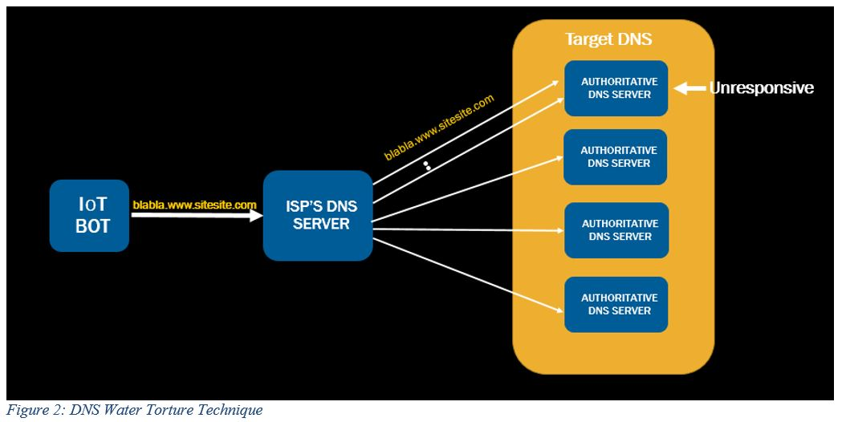
DNS Water Torture = Reflection + Amplification

Slide 31
DDoS TCP SYN Flood
Attacker
Server
Spoofed Client
Insights:
Traffic pattern
Spoofed IPs
Send Spoofed SYN
Send SYN-ACK
Resend SYN-ACK

Slide 32
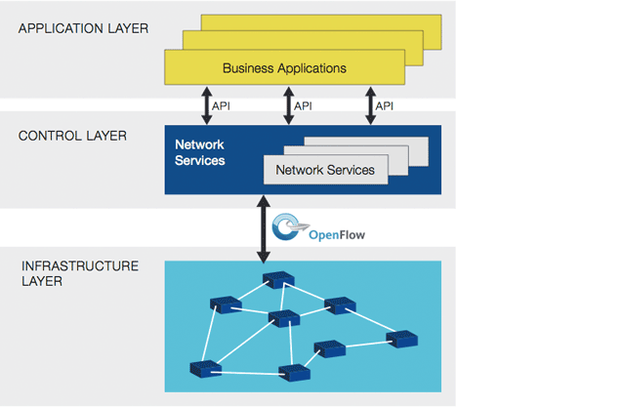
Motivation
Software Defined Networking (SDN)
SDN Capabilities
Drop flows
Redirect flows
Duplicate flows
Information available & accessible on different network layers
Source: https://www.opennetworking.org/sdn-resources/sdn-definition

Slide 33
Challenges
Intrusion Detection System (IDS)
Data availability is limited
Effectiveness depends on position in network
SDN Controller
Bottleneck – cannot analyze every packet
Effectiveness depends on position in network
Accuracy vs Performance
Real world implementation

Slide 34
Solutions
Discrete attack signature constituents
Increase in SYN packets
Spoofed source IPs for certain DDoS instances
IDS elements
Distributed
Communication with SDN controllers
SDN controllers posses critical information
Flow table
Add/remove flows
Duplicate flows
Emulation with Global Environment for Network Innovations

Slide 35
Processing overhead
Attack
Increase of normal traffic
Network traffic
Detection Stage
Monitor(s)
t
Alert message
Correlation Stage
Evidence/ command
Reset message
Reset
Correlator(s)
t
Mitigation Stage
Attack confirmed
Reset
Controller(s)
t

Slide 36
An easy fix?
How do you solve distributed denial of service?

Slide 37
Simple DDoS Mitigation
Ingress/Egress Filtering: Helps spoofed sources, not much else
Better Security
Limit availability of zombies (not feasible)
Prevent compromise and viruses (maybe in wonderful magic land where it rains chocolate and doughnuts)
Quality of Service Guarantees (QoS)
Pre- or dynamically allocated bandwidth (e.g., diffserv)
Helps where such things are available
Content replication
Useful for static content

Slide 38
Pushback
Initially, detect the DDoS and flag the sources/types/ links of DDoS traffic
Pushback on upstream routers
Contact upstream routers using PB protocol
Indicate some filtering rules (based on observed flows)
Repeat as necessary towards sources
Works well in wonderful magic land where it rains chocolate and doughnuts

Slide 39
Traceback
With small probability (e.g., 1/20,000), routers include identity of previous hop with packet data
For large flows, targets can reconstruct path to source
Statistics say that the path will be exposed

Slide 40
DDoS Reality
None of the “protocol oriented” solutions have really seen any adoption
too many untrusting, ill-informed, mutually suspicious parties must play together
Real Solution
Large ISPs police their ingress/egress points very carefully
Watch for DDoS attacks and filter appropriately
Develop products that coordinate view from many vantage points in the network to identify upswings in traffic

Slide 41
Source Routing
Standard IP Packet Format (RFC791)
Source Routing allows sender to specify route
Set flag in Flags field
Specify routes in Options field

Slide 42
Source Routing
Q: What are the security implications of Source Routing?
Q: What are the possible defenses?
Notes:
• Access control?
• DoS?
• A: Block packets with source-routing flag

Slide 43
Routing Manipulation
RIP - Routing Information Protocol
Distance vector routing protocol used for the local network
Routers exchange reachability and “distance” vectors for all the sub-networks within (a typically small) domain
Use vectors to decide which route is best
Problem: Data (vectors) are not authenticated
Forge vectors to cause traffic to be routed through adversary
or cause DoS
Solutions: ?
Notes:
(still an open problem)

Slide 44
ICMP
ICMP is used as a control plane for IP messages
Ping (connectivity probe)
Destination unreachable (error notification)
Time-to-live exceeded (error notification)
Some ICMP messages cause clients to alter behavior: e.g., TCP RSTs on destination unreachable or TTL-exceeded
ICMP messages are easy to spoof: no handshake
Enables attacker to remotely reset others’ connections
Solution:
Verify/sanity check sources and content
Filter most of ICMP

Slide 45
Ping of Death
IP Fragmentation
16-bit “Total Length” field allows ??? byte packets
Data link (layer 2) often imposes significantly smaller Maximum Transmission Unit (MTU) (normally 1500 bytes)
Fragmentation supports packet sizes greater than MTU and less than max packet size
13-bit Fragment Offset specifies offset of fragmented packet, in units of 8 bytes
Receiver reconstructs IP packet from fragments, and delivers it to Transport Layer (layer 4) after reassembly

Slide 46
Ping of Death

Slide 47
Ping of Death
Maximum packet size: 65,535 bytes
Maximum 13-bit offset is (2¹³ - 1) * 8 = 65,528
In 1996, someone discovered that many operating systems, routers, etc. could be crash/rebooted by sending a single malformed packet
If packet with maximum possible offset has more than 7 bytes, IP buffers allocated with 65,535 bytes will be overflowed
..causing crashes and reboots
Not really ICMP specific, but easy
% ping -s 65510 your.host.ip.address
Most OSes and firewalls have been hardened against PODs
This was a popular pastime of early hackers

Slide 48
ARP Spoofing

Slide 49
ARP Spoofing
Each ARP response overwrites the previous entry in ARP table -- last response wins!
Attack: Forge ARP response
Effects:
Man-in-the-Middle
Denial-of-service
Also called ARP Poisoning or ARP Flooding

Slide 50
ARP Spoofing: Defenses
Smart switches that remember MAC addresses
Switches that assign hosts to specific ports

Slide 51
Legacy flawed protocols and services
Finger user identity: host gives up who is logged in, existence of identities
This is horrible in a distributed environment. Why?
Notes:
• Privacy, privacy, privacy ... • Lots of information to start a compromise of the user.

Slide 52
POP/SMTP/FTP
Post office protocol - mail retrieval
Passwords passed in the clear
Solution: SSL, SSH, Kerberos
Simple mail transport protocol (SMTP) - email
Nothing authenticated: SPAM
Nothing hidden: eavesdropping
Solution: ?
File Transfer protocol - file retrieval
Passwords passed in the clear
Solution: SSL, SSH, Kerberos

Slide 53
Summary
The Internet was built for robust communication
Smartness occurs at the end-hosts (see End-to-End Principle)
Does this design support or hinder network security?

Slide 54
And if we had to start all over again, could we do better?

Slide 55
Worms

Slide 56
Worms
A worm is a self-propagating program that:
Exploits some vulnerability on a target host
(often) imbeds itself into a host ...
Searches for other vulnerable hosts ...
Goto step 1

Slide 57
The Danger
What makes worms so dangerous is that infection grows at an exponential rate
A simple model:
s (search) is the time it takes to find vulnerable host
i (infect) is the time is take to infect a host
Assume that t=0 is the worm outbreak, the number of hosts at t=j is $2^{(\frac{j}{(s+i)})}$

Slide 58
The result

Slide 59
Morris Worm – Nov. 2nd 1988
6pm: someone ran a program at a computer at MIT
The program collected host, network, and user info...
... and then spread to other machines running Sun 3, VAX, and some BSD variants
... rinse and repeat

Slide 60
Morris Worm
Computers became multiply infected
Systems became overloaded with processes
Swap space became exhausted, and machines failed
Wednesday night: UC Berkeley captures copy of program
5AM Thursday: UC Berkeley builds sendmail patch to stop spread of worm
Difficult to spread knowledge of fix
Not coincidentally, the Internet was running slow
Around 6,000 machines (~10% of Internet) infected at cost of $10M-$100M

Slide 61
Morris Worm Attack Vectors
rsh: terminal client with network(IP)-based authentication
fingerd: used gets call without bounds checking
sendmail: DEBUG mode allows remoteuser to run commands
lots of sendmail daemons running in DEBUG mode

Slide 62
Stuxnet
First reported June 2010
Exploited unknown vulnerabilities
Not one zero-day
Not two zero-days
Not three zero-days
But four zero-days!
print spooler bug
handful of escalation-of-privilege vulnerabilities

Slide 63
Stuxnet
Spread through infected USB drives
bypasses “air gaps”
Worm actively targeted SCADA systems (i.e., industrial control systems)
attempted 0-day exploit
also tried using default passwords
apparently, specifically targeted Iran’s nuclear architecture
Once SCADA system compromised, worm attempts to reprogram Programmable Logic Controllers (PLCs)
Forensics aggravated by lack of logging in SCADA systems

Slide 64
Worms and infection
The effectiveness of a worm is determined by how good it is at identifying vulnerable machines
Multi-vector worms use lots of ways to infect: e.g., network, email, drive by downloads, etc.
Example scanning strategies:
Random IP: select random IPs; wastes a lot of time scanning “dark” or unreachable addresses (e.g., Code Red)
Signpost scanning: use info on local host to find new targets (e.g., Morris)
Local scanning: biased randomness
Permutation scanning: “hitlist” based on shared pseudorandom sequence; when victim is already infected, infected node chooses new random position within sequence

Slide 65
Worms Defense Strategies
(Auto) patch your systems: most large worm outbreaks have exploited known vulnerabilities (Stuxnet is an exception)
Heterogeneity: use more than one vendor for your networks
IDS: provides filtering for known vulnerabilities, such that they are protected immediately (analog to virus scanning)
Filtering: look for unnecessary or unusual communication patterns, then drop them on the floor

Slide 66
Sources
"Security problems in the TCP/IP protocol suite”, S.M. Bellovin, AT&T Bell Laboratories, 1998
Tommy Chin, Xenia Mountrouidou, Xiangyang Li, Kaiqi Xiong, “An SDN-Supported Collaborative Approach for DDoS Flooding Detection and Containment“, International Conference for Military Communications (MILCOM 2015), Tampa, Florida, 2015
Mirai Botnet: https://f5.com/labs/articles/threat-intelligence/ddos/mirai-the-iot-bot-that-took-down-krebs-and-launched-a-tbps-attack-on-ovh-22422

